Slide 1


Phase II – Intake Damage and Eligibility Analysis
Notes:
Instructor Notes:
- Introductory Slide

Slide 2
Phase II – Intake Damage and Eligibility Analysis – Action Items
DETERMINATION
MEMO
PHASE II
PHASE I
NO
YES
RECOVERY SCOPING MEETING
PDMG LOGICALLY GROUPS DAMAGES
FACILITY
ELIGIBLE?
YES
WORK COMPLETE?
NO
CONTACT SPECIAL CONSIDERATIONS AS NECESSARY
PHASE II TRANSITION
Notes:
Instructor Slide:
- Similar to previous slide, but show the transition phase. Inform the class that Phase II will be discussed in detail through the next Unit.

Slide 3
Phase II – Intake Damage and Eligibility Analysis – Action Items
PHASE II
PDMG FORMULATES
COMPLETED LANE PROJECT
PDMG SENDS REQUEST FOR ESSENTIAL ELEMENTS OF INFORMATION
YES
PDMG FORMULATES STANDARD PROJECT
WORK COMPLETE?
NO
NO
PDMG SENDS REQUEST FOR ESSENTIAL ELEMENTS OF INFORMATION
PDMG CREATES SITE INSPECTION WORK ORDER
NO
SPECIALIZED OR TECHNICAL WORK?
SPECIALIZED OR TECHNICAL WORK?
PDMG FORMULATES SPECIALIZED PROJECT
YES
YES
Notes:
Instructor Notes:
- Review the transition from Phase I into Phase II.

Slide 4

DETERMINATION MEMO
PHASE II
NO
APPLICANT SUBMITS ESSENTIAL ELEMENTS OF INFORMATION DOCUMENTATION
PDMG SUBMITS WORK COMPLETED PROJECT TO CRC
ELIGIBLE?
YES
DETERMINATION MEMO
STANDARD
LANE
SEND SITE INSPECTION WORK ORDER – WORK TO BE COMPLETED
SITE INSPECTOR CONDUCTS SITE INSPECTION
PDMG REVIEWS SIR / DDD
PDMG REVIEWS AND CONFIRMS LOGICAL GROUPINGS OF DAMAGE
NO
APPLICANT SUBMITS ESSENTIAL ELEMENTS OF INFORMATION DOCUMENTS
APPLICANT REVIEWS & SIGNS
DDD
SPECIALIZED
LANE
ELIGIBLE?
YES
SEND SITE INSPECTION WORK ORDER – WORK TO BE COMPLETED
TECHNICAL SPECIALIST CONDUCTS SITE INSPECTION
PDMG REVIEWS SIR / DDD
PDMG REVIEWS AND CONFIRMS LOGICAL GROUPINGS OF DAMAGE
CONTACT SPECIAL CONSIDERATIONS AS NECESSARY
Notes:
Instructor Notes:
- Introduce the course attendees to the Phase II Work Flow. Inform the class that steps will be reviewed in detail.

Slide 5
COMPLETED
LANE
PHASE II
PHASE III
PDMG SUBMITS WORK COMPLETED PROJECT TO CRC
COMPLETED LANE LEAD ASSIGNS VALIDATION SPECIALIST
APPLICANT DEVELOPS SCOPE OF WORK AND COSTS
YES
STANDARD
LANE
STANDARD
LANE
SPECIALIZED
LANE
IS APPLICANT DRAFTING SCOPE OF WORK AND COSTS?
STANDARD LANE LEAD ASSIGNS COSTING SPECIALIST
APPLICANT REVIEWS & SIGNS
DDD
PDMG COMPLETES DEVELOPMENT GUIDE QUESTIONS
PDMG SUBMITS STANDARD/ SPECIALIZED PROJECT TO CRC
NO
SPECIALIZED
LANE
PHASE II TRANSITION TO PHASE III
SPECIALIZED LANE LEAD ASSIGNS TECHNICAL SPECIALIST
CONTACT SPECIAL CONSIDERATIONS AS NECESSARY
PHASE III TRANSITION
Notes:
Instructor Notes:
Review the transition process from Phase II into Phase III.
Ensure Students have a clear picture of where the project is going into Scoping an Costing

Slide 6
OBJECTIVES
Capture Applicant’s disaster related damage and determine eligibility within 60 days of the Recovery Scoping Meeting (RSM) through:
  Logically Group Damage Line Items Into Projects
  Complete Site Inspections
  Applicants Receive Essential Elements of Information Requests
  Applicants Fulfill Document Disclosure Through EEI Process
  Applicant Agreement to Damage Description and Dimensions for Standard and Specialized Projects.
Notes:
Instructor Note:
Inform the Attendees that the FEMA PDMG will assist the Applicant by collecting all the damage information and documentation. The Information will be routed to the CRC.

Slide 7
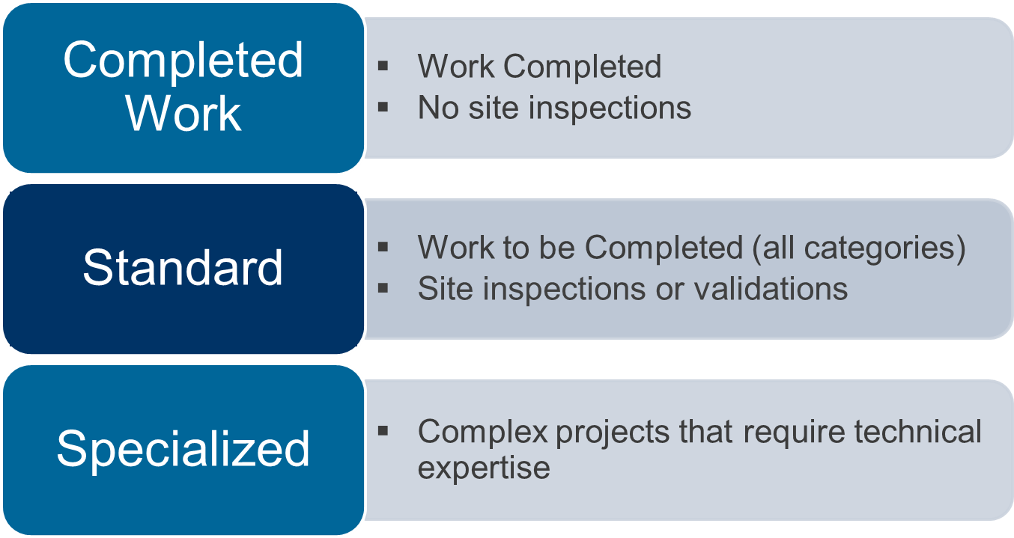
The FEMA Program Delivery Manager (PDMG) designates disaster damages into Project Lanes
Notes:
Instructor Notes:
Orient the Class with each of the Project Lanes
Clarify Questions
Clearly define the slide bullet points

Slide 8
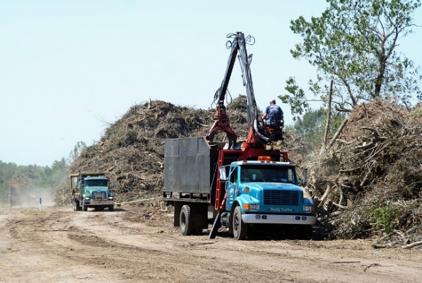
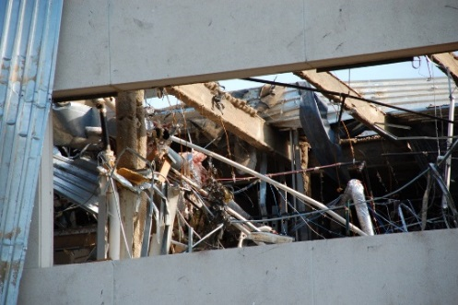
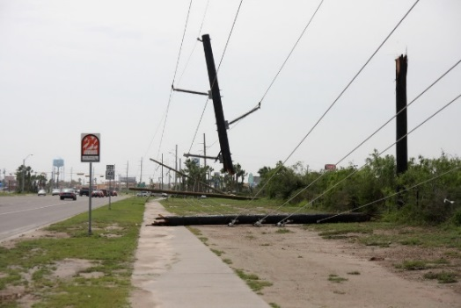
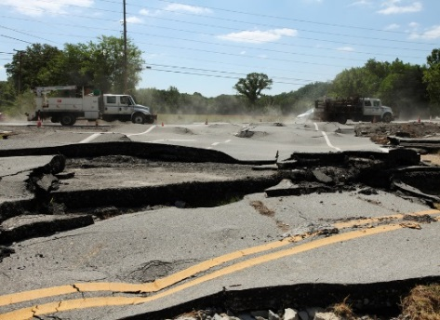
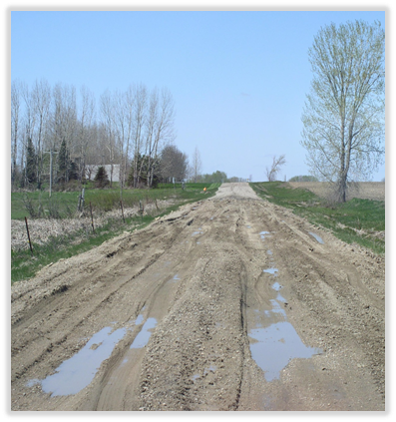
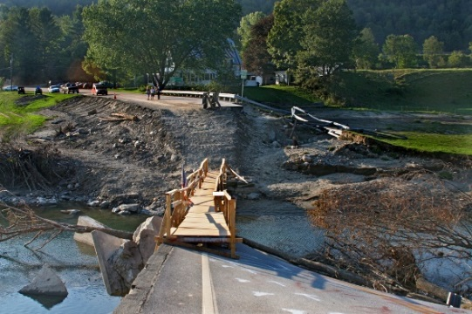
Phase II – Intake Damage and Eligibility Analysis – Action Items
Discussion
For each lane, what types of damage should be considered?
For Work Orders, how could damages be logically grouped?
Do Work Order Grouping constitute Project Formulation?
Notes:
Instructor Notes:
Class Activity. Have the class consider various types of damage and what types of project lanes each damage item may belong in. Take Approximately 5-10 Minutes for the Activity to expose participants to Project Lanes and considerations.
Ensure to differentiate between project grouping and Project Formulation.

Slide 9

Phase II – Intake Damage and Eligibility Analysis – Action Items
Essential Elements of Information
Notes:
Instructor Notes:
Have the Participants open the Checklists. Review all the components and discuss the PDMG Roles throughout.
Inform the Attendees that the Applicants will receive the Document Checklists through email following the Exploratory Call and Hard Copies of the Checklists will be provided at the Recovery Scoping Meeting.

Slide 10
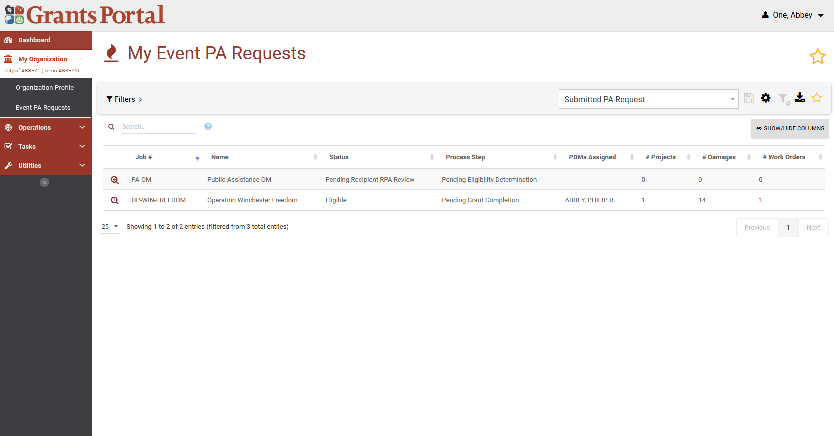
Event Profile – Documents to Projects
Step 1: Select My Organization
Step 3: Drill into
Event
Step 2: Select My Event PA Requests

Slide 11
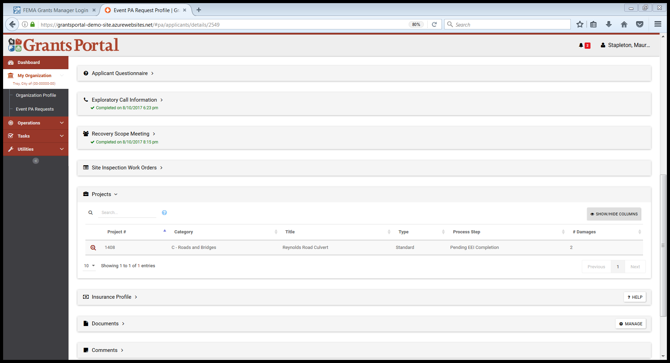
Locating Projects
Step 1: Expand Projects Bar
Step 2: Drill into Project

Slide 12
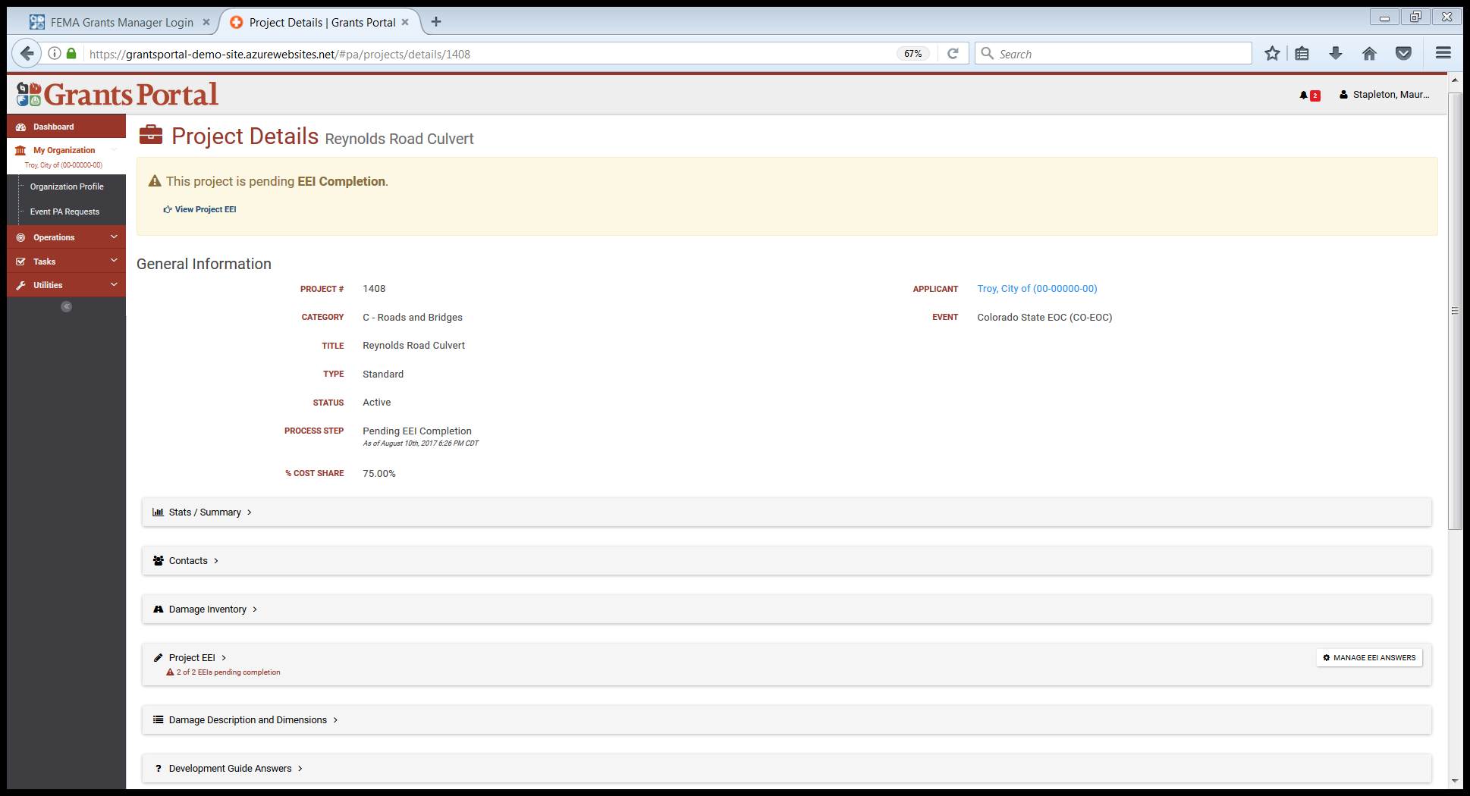
Locating Projects
Click View Project EEI
OR Expand Project EEI

Slide 13
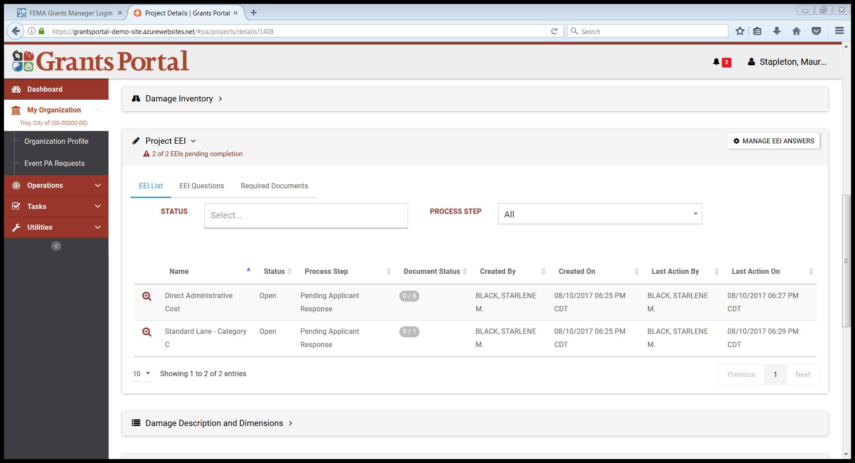
Locating Projects
Drill Into Project

Slide 14
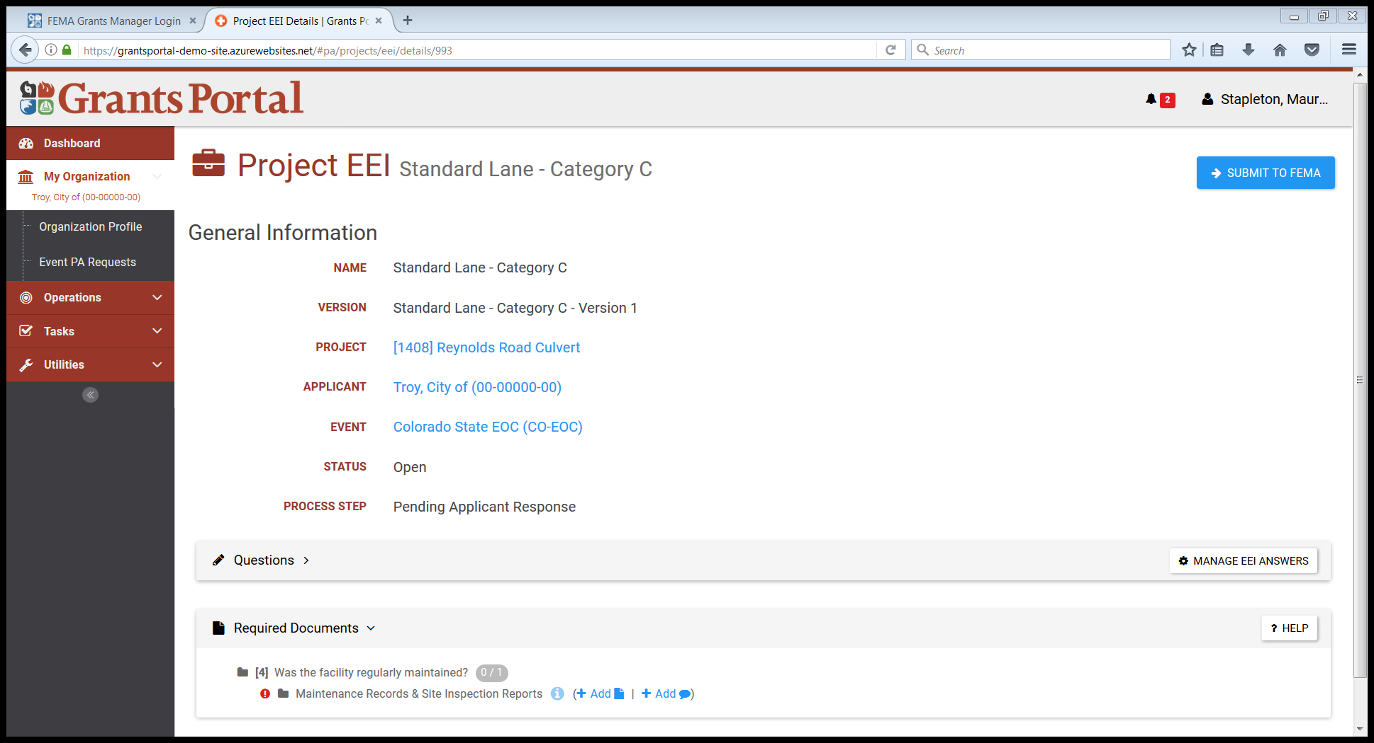
Attaching Documents to EEI
Click Add

Slide 15
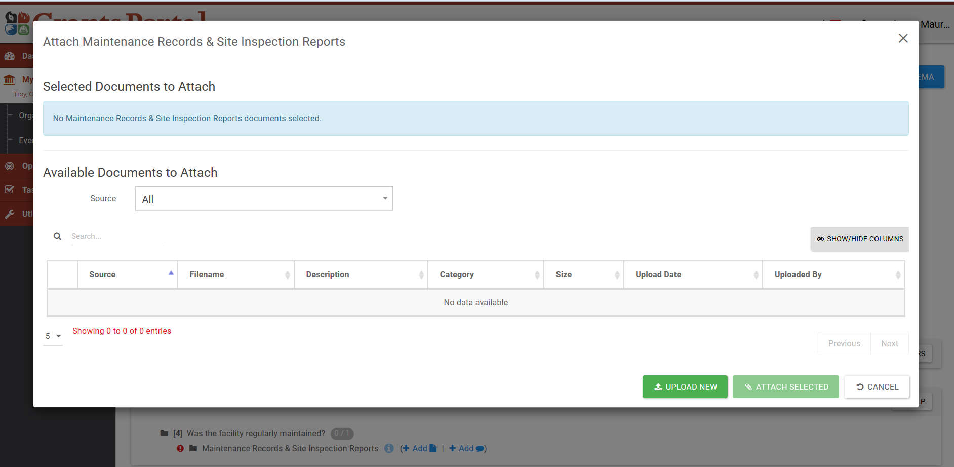
Attaching Documents to EEI – Pop Up Box – New Document
Click Upload New

Slide 16
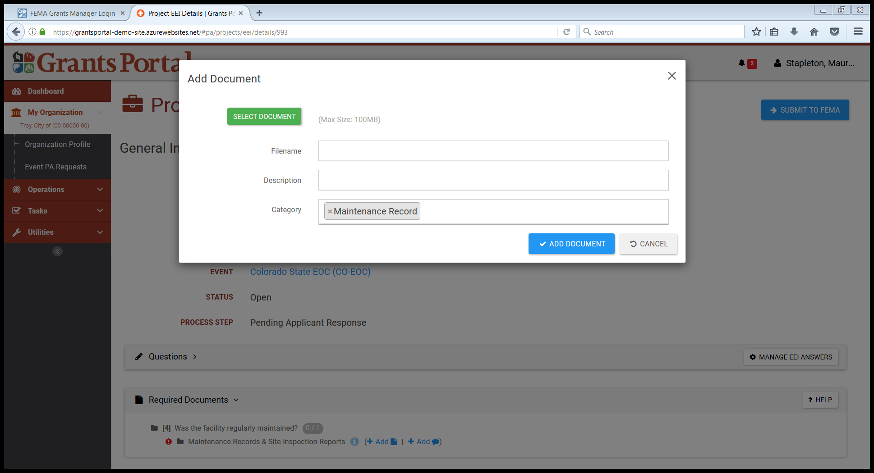
Attaching Documents to EEI – Pop Up Box – New Document
Click Select Document

Slide 17
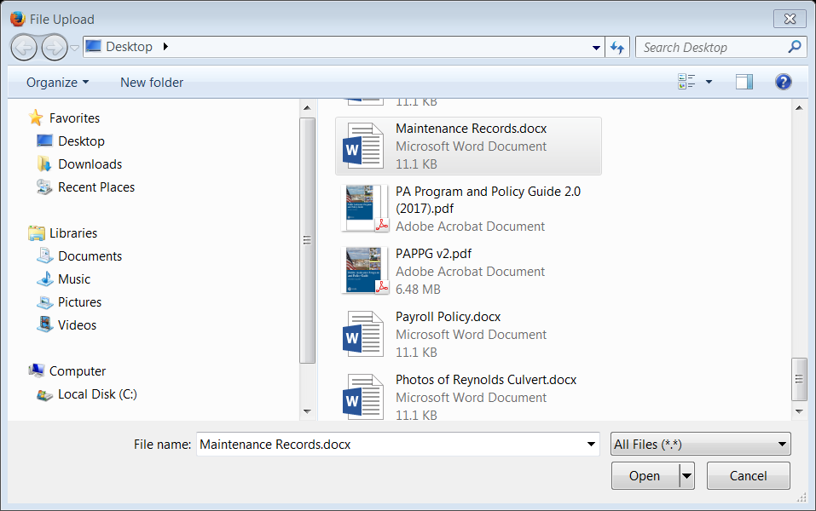
Attaching Documents to EEI – Pop Up Box – New Document
Step 1: Click on Document
Step 2: Click Open

Slide 18
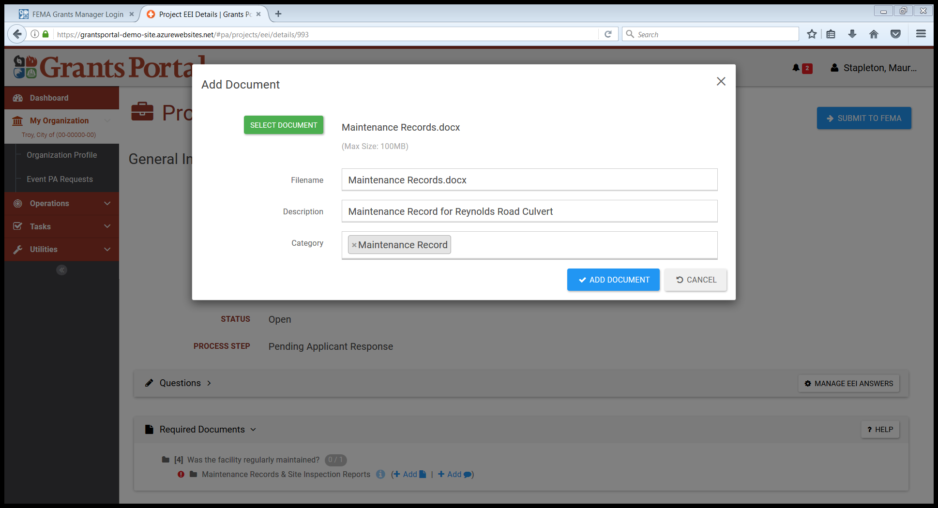
Attaching Documents to EEI – Pop Up Box – Add Description and Upload Document
Step 1: Type Description of Document
Step 2: Click Add Document

Slide 19
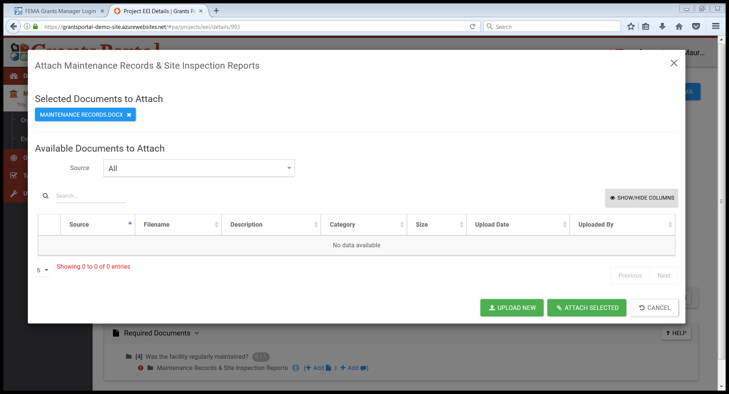
Attaching Documents to EEI – Pop Up Box – Attach Uploaded Document
Step 1: Move Mouse over file to verify correct document
Step 2: Click Attach Document

Slide 20
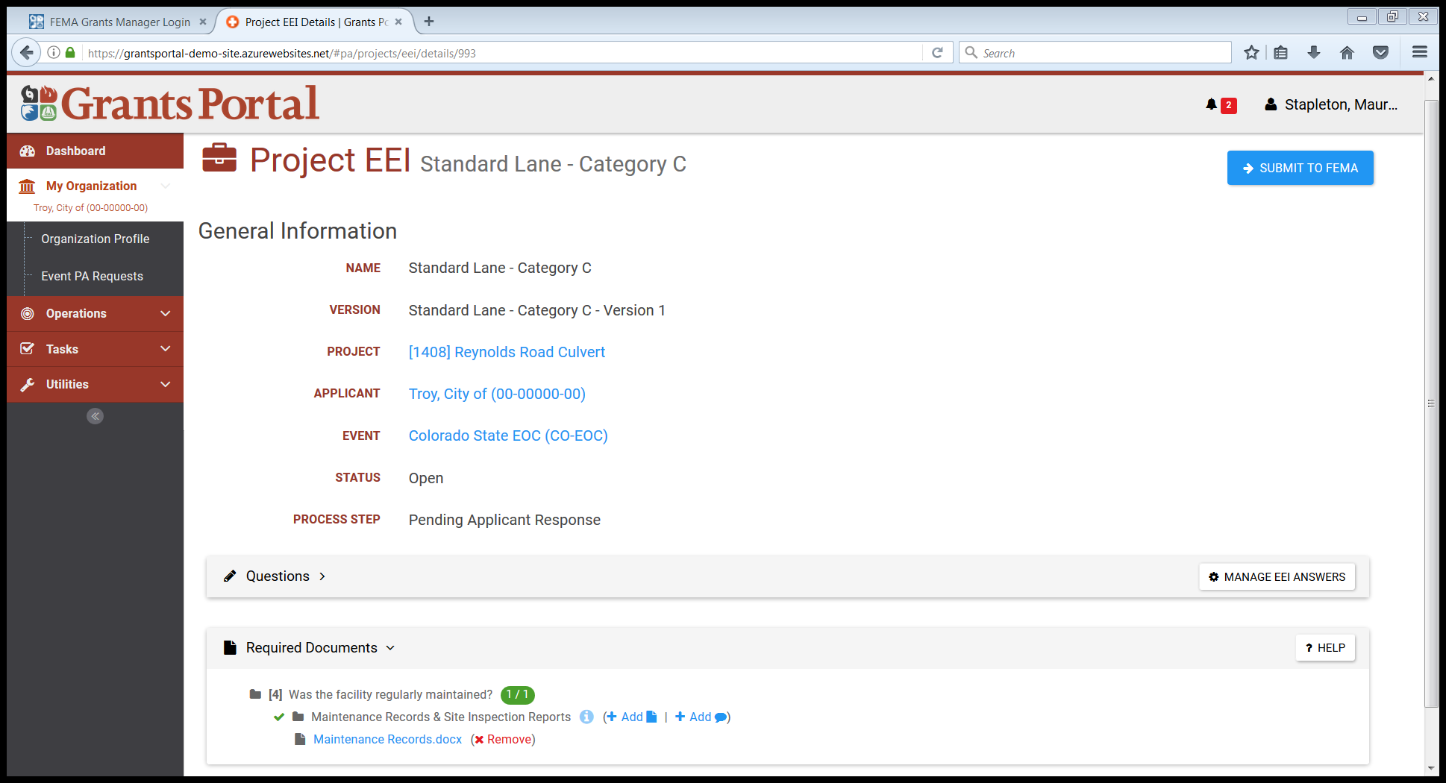
Remove Documents from EEI
Click Remove

Slide 21
Send EEI Back to FEMA
Click Submit to FEMA

Slide 22
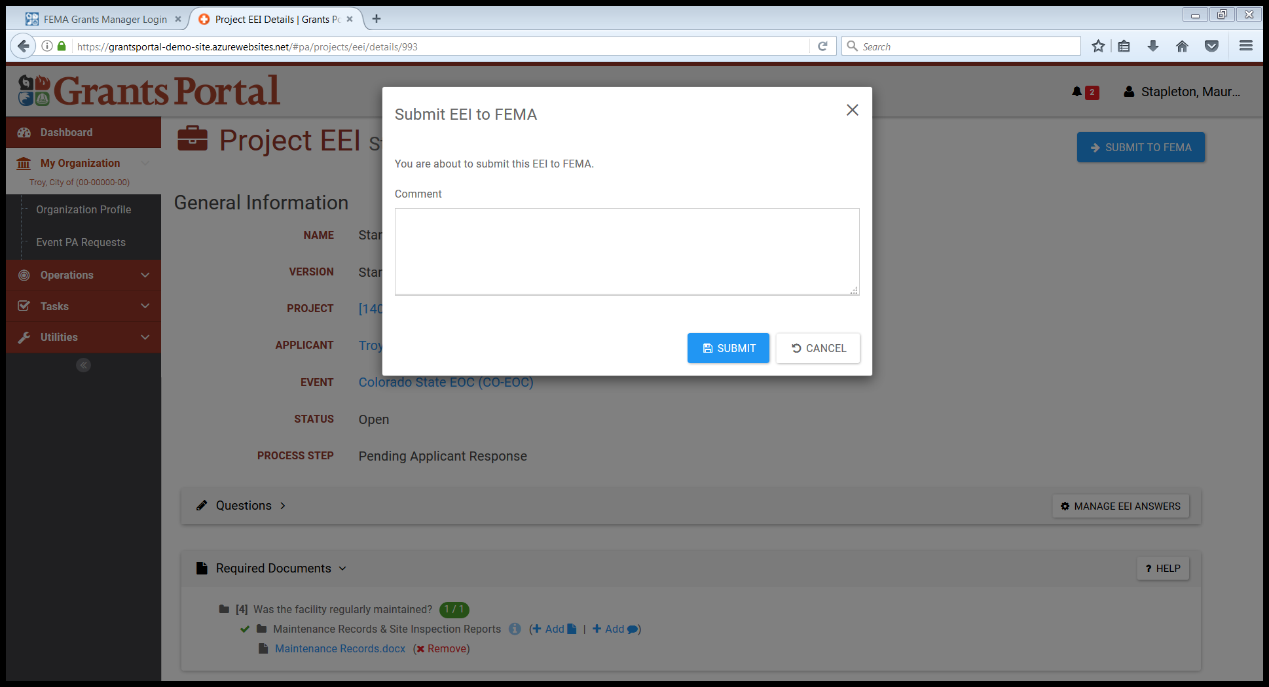
Send EEI Back to FEMA
– Confirmation Pop Up Box
Click Submit

Slide 23

Essential Elements of Information (EEI)
Add Comments

Slide 24
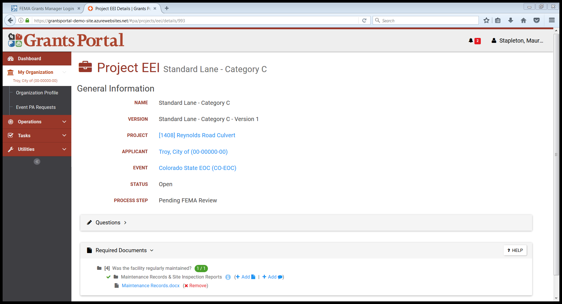
Add Comments to EEI
Click Add

Slide 25
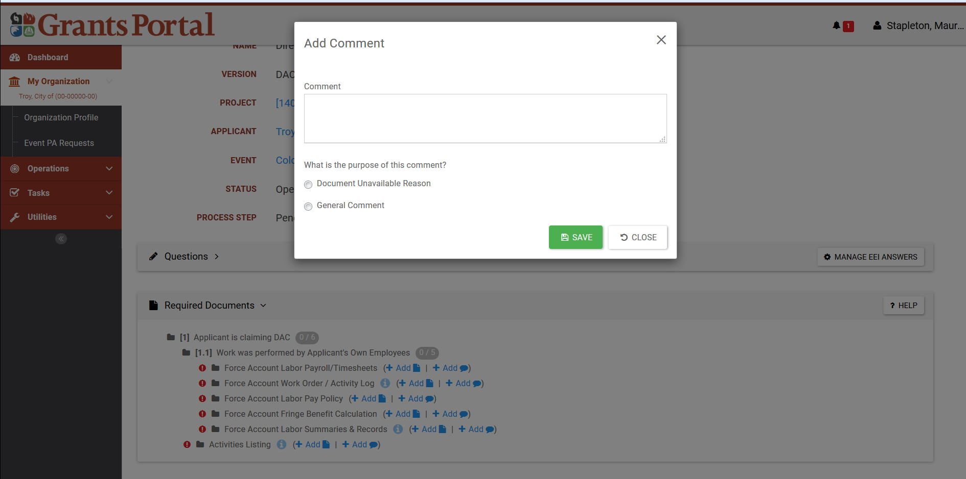
Add Comments to EEI
Step 1: Type Comment
Step 2: Select Type of Comment
Step 3: Click Save

Slide 26
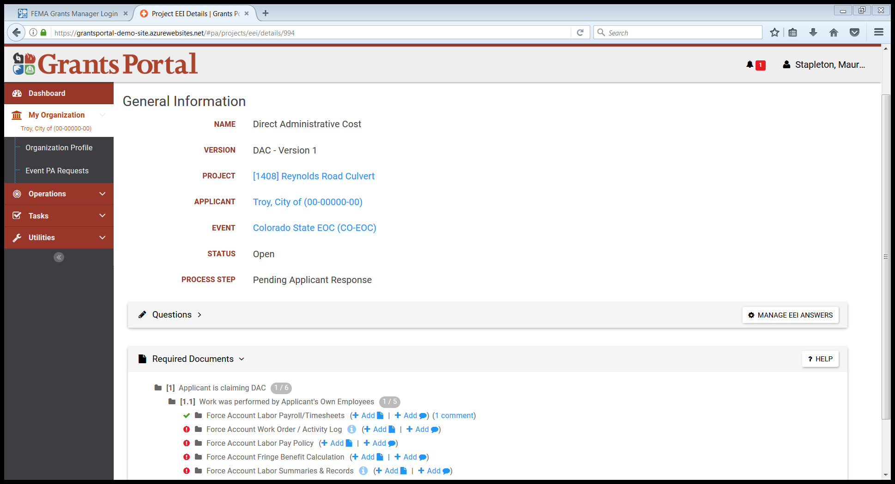
Verify Comment Attached
Verify Comment Attached

Slide 27
Identify Tasks to Complete

Slide 28
Identify Tasks to Complete
Click Bell

Slide 29
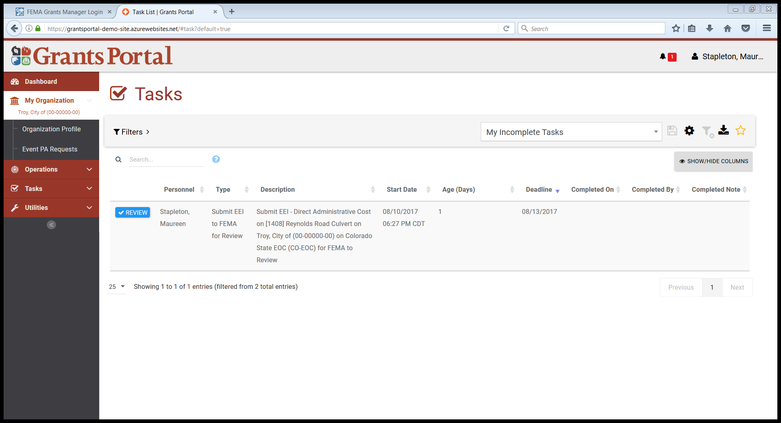
Identify Tasks to Complete
Click Review on any task

Slide 30
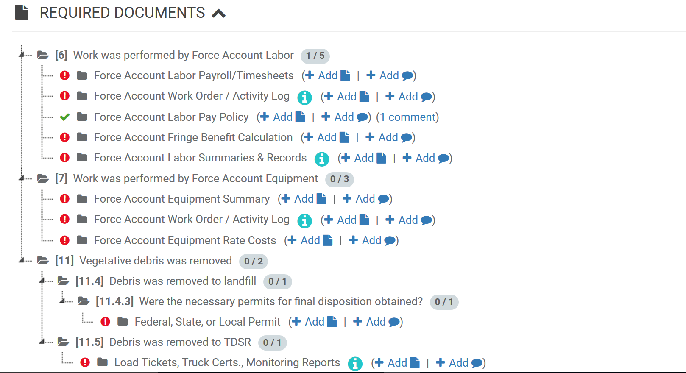
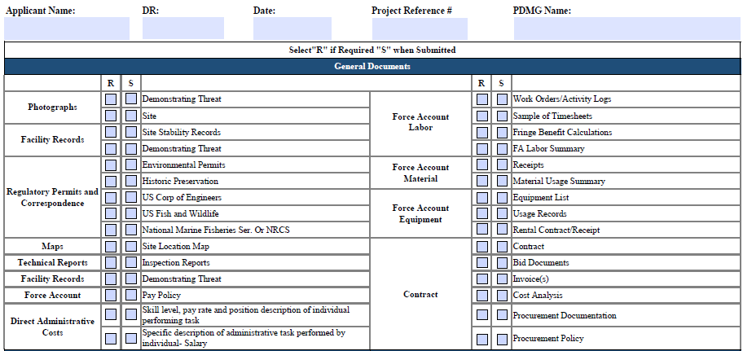
Phase II – Intake Damage and Eligibility Analysis – Action Items
Essential Elements of Information
ACTIVITY – Document Checklists as a Resource Tool
Notes:
Instructor Notes:
Have the Participants open the Checklists. Review all the components and discuss the PDMG Roles throughout.
Inform the Attendees that the Applicants will receive the Document Checklists through email following the Exploratory Call and Hard Copies of the Checklists will be provided at the Recovery Scoping Meeting.

Slide 31
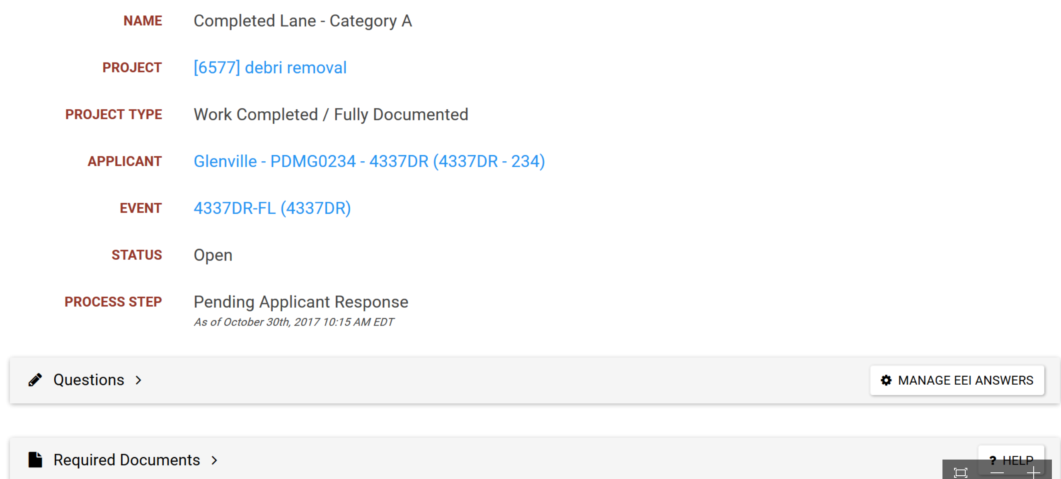
Phase II – Intake Damage and Eligibility Analysis – Action Items
EEI completed input
Notes:
Inform Applicant that the “Manage EEI Answers” button will transmit required documentation and queries back to the Program Delivery Manager

Slide 32
Phase II – Intake Damage and Eligibility Analysis – Action Items
Completed Work
Work is 100% Completed.
May include work identified to be 100% complete within 2 weeks of Recovery Scoping Meeting.
Program Delivery Manager Formulates the Project and requests Essential Elements of Information
Only submitted to CRC at the conclusion of Phase II when all required documentation outlined in the Essential Elements of Information is submitted.
Notes:
Instructor Note:
Inform the Attendees that the FEMA PDMG will assist the Applicant by collecting all the damage information and documentation. The Information will be routed to the CRC.

Slide 33
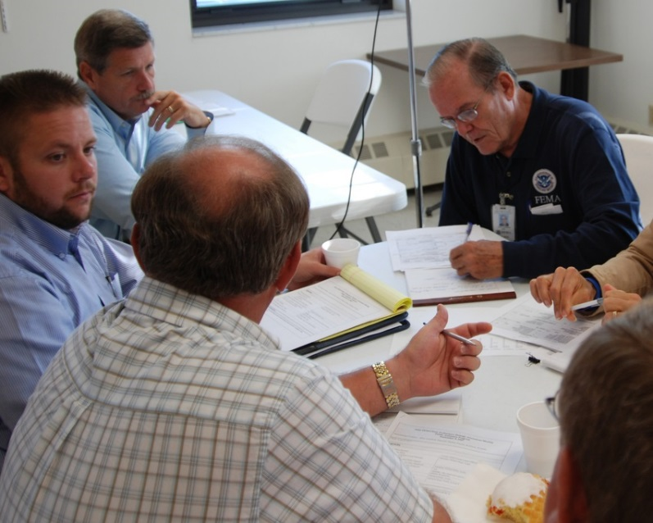
Phase II – Intake Damage and Eligibility Analysis – Action Items
The Completed/Documented Lane Workflow
Throughout the entire process, the FEMA Program Delivery Manager works with/supports the Applicant to:
Organize Documents
Upload/Submit Documents
Answer Questions
Resolve Unmet Needs
Achieve Field Level Agreement
Recipients are invited to partner with the Applicant and FEMA through all engagements.
Notes:
Instructor Notes:
Continue to enforce the role of the Program Delivery Manager.
Outline ongoing roles and work with the Applicant
Define the potential roles the Recipient may have either supporting the FEMA PDMG or the Applicant in the process. The Recipient may choose to mirror the PDMG if Recipient staffing capacity allows for it.

Slide 34
Phase II – Intake Damage and Eligibility Analysis – Action Items
Will Work Completed ever require Site Inspections?
Notes:
Instructor Notes:
Site Inspections do occur on grouped projects where a completed work site may be the component of an overall project that is not complete.
Example: A baseball field has damage to fences, light poles, scoreboard and dugouts → Fences have been repaired, but the remaining work is incomplete.
For the completed portion, the Site Inspector will complete a validation of the fence and capture components/dimensions in order to include the damaged element in the DDD.
In the example: if all components of the ballfield were repaired (fences, light poles, scoreboards, and dugouts), then the PDMG works with the Applicant to complete a DDD, and a Site Inspection and/or Site Validation will not occur.
Remind participants that an overall project can be deemed 100% complete in the lane process if the project will be complete within 2 weeks of the Recovery Scoping Meeting.
Applicant and Recipient Consideration: For 100% completed projects, the Recipient may assist the Applicant with DDD development and demonstration of damage. It is the Applicant responsibility to demonstrate damage through photographs and records.

Slide 35
Phase II – Intake Damage and Eligibility Analysis – Action Items
Standard Lane (Non-Technical) and Specialized Lane (Technical) damages:
Each lane follows a similar workflow processes.
Analyzed by FEMA Program Delivery Manager (PDMG) through collaborative process with the Recipient - to place the right skillset proficiency with the damage.
Organized into Work Orders by PDMG for:
→ Site Inspectors (Standard/Non-Technical)
→ Technical Specialists (Specialized/Technical)
Notes:
Instructor Notes:
This slide begins the course transition into the Site Inspection Process.
Additional details will be taken in steps throughout the Unit.
Overview the slide bullet points and proceed to next slide.

Slide 36
Phase II – Intake Damage and Eligibility Analysis – Action Items
Site Inspection Work Order Process:
Developed Work Orders are designated to the FEMA Site Inspector Task Force Leader.
Site Inspector Task Force Lead assigns a FEMA Site Inspector.
Site Inspection calls Applicant day before Site Inspection to confirm date, time, and location where they will meet.
Notes:
Instructor Notes:
- For the next 2 slides, Articulate and describe the FEMA Work Order Cycle.

Slide 37
Phase II – Intake Damage and Eligibility Analysis – Action Items
Work Order Process (Continued):
Site Inspections are completed
Site Inspector develops the Damage Description & Dimensions
Program Delivery Manager reviews Damage Description & Dimensions
FEMA Program Delivery Manager meets with the Applicant for Review and Signature.
Notes:
Instructor Notes:
- Work Order Cycle Continued.

Slide 38
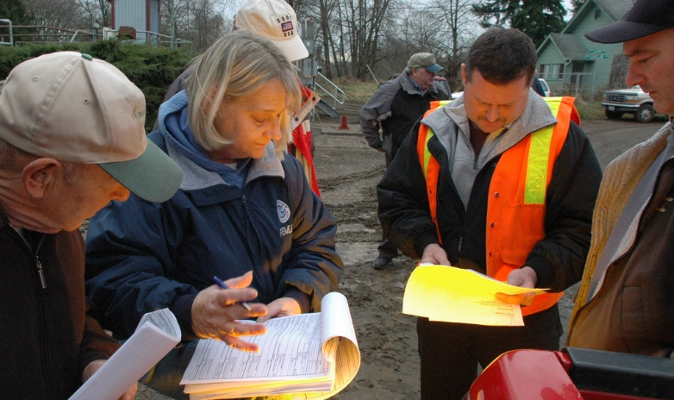
Phase II – Introduction to the FEMA Site Inspector
Applicant Roles:
Must be present at all Site Inspections
Identifies all site damage and components
Answers Special Considerations Questions
Signs the Site Inspection Report
Notes:
Instructor Notes:
- Work through the bullet points. Highlight each and proceed to the next slide.

Slide 39

Phase II – Introduction to the FEMA Site Inspector
Applicant Roles (Continued):
Applicant will need to identify their representative that will attend each site inspection. Representative will be required to sign the Site Inspection Report confirming measurements.
Prior to Site Inspection, the representative can anticipate:
An introductory phone call from the Site Inspector.
Confirmation of the date, time and meeting location.
Identification of what to bring.
An opportunity to ask questions.
Notes:
Instructor Notes:
- Inform Applicant participants what to expect from the Site Inspector and how they will be engaged.

Slide 40
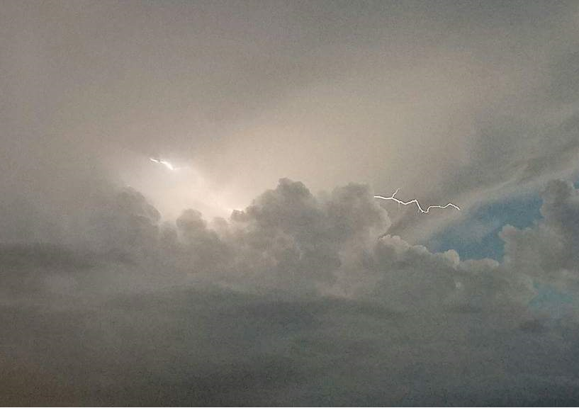
Phase II – Introduction to the FEMA Site Inspector
Applicant Roles (Continued):
Need to cancel a Site Inspection?
Conflicting Appointments
Unexpected deadlines
Adverse Weather Conditions
Contact the FEMA Program Delivery Manager. The PDMG will notify all FEMA/Recipient counterparts and coordinate with the FEMA Site Inspector to re-schedule.
Notes:
Instructor Notes:
- Address slide comments and discuss issues that can occur during recovery.

Slide 41

Phase II – Introduction to the FEMA Site Inspector
Applicant Roles (Continued):
In Preparation the Applicant should gather any measurement tools that may be helpful.
Measuring Wheels***
Measuring Tapes***
Tape Measures***
Building Plans/Drawings
Disaster Photos (and/or Pre-Disaster Photos)
*** FEMA will issue measuring tools/equipment to Site Inspectors. However, resources on hand may be helpful to the Site Inspection process.
Notes:
Instructor Notes:
- Inform Applicant participants what to expect from the Site Inspector and how they will be engaged.

Slide 42
Phase II – Introduction to the FEMA Site Inspector
Applicant Roles (Continued):
At the time of Site Inspection, the Applicant will:
Meet with the Site Inspector.
Review the Work Order Together.
Plan a time effective strategy/plan to see sites.
Facilitate inspections of the designated sites on the Work Order.
Notes:
Instructor Notes:
- Inform Applicant participants what to expect from the Site Inspector and how they will be engaged.

Slide 43
Phase II – Introduction to the FEMA Site Inspector
Applicant Roles (Continued):
What happens at Site Inspection Conclusion?
Site Inspector will discuss next steps with Applicant.
The Applicant will be asked to Sign the Inspection Report.
Notes:
Instructor Notes:
Remind the class that the Site Inspectors mission is to annotate ALL damages
In the process, the Site Inspector will seek Applicant Agreement
Applicant Agreement is essential for the project to move forward
The Applicant needs to sign each Site Inspection. If the Site Inspector has not asked for Signature, the Applicant may request opportunity to review and sign.

Slide 44
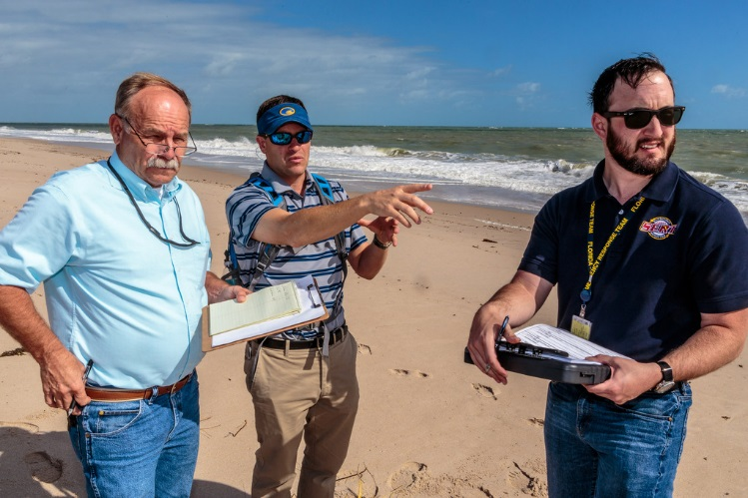
Phase II – Introduction to the FEMA Site Inspector
Recipient Roles:
Openly invited to attend FEMA Site Inspections
May assist either FEMA or the Applicant by:
  Asking questions
  Taking Measurements
  Obtaining site photos
  Drawing site sketches
Notes:
Instructor Notes:
Enforce that Recipients can have an active partnership role in the process.
Follow the bullet point and discuss as necessary.
Invest time with the class to answer all questions.

Slide 45
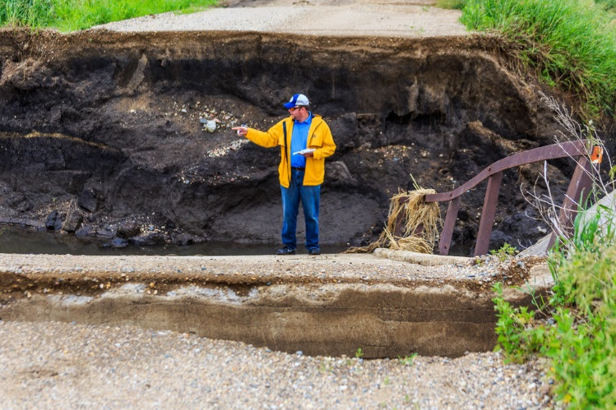
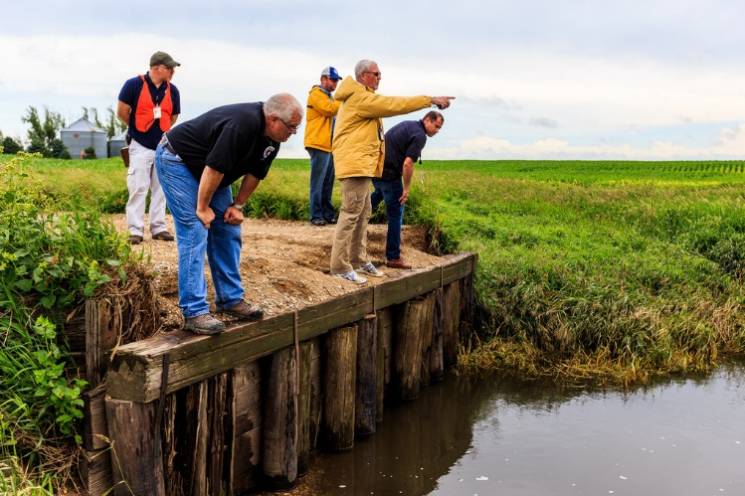
Phase II – Introduction to the FEMA Site Inspector
FEMA SITE INSPECTOR VIDEO
https://www.youtube.com/watch?v=-MCBCoAgIeQ&feature=youtu.be
Notes:
Instructor Notes:
- Show the Video to the class.

Slide 46
Phase II – Introduction to the FEMA Site Inspector
In the New PA Delivery Model:
The Program Delivery Manager (PDMG) remains the Applicant’s single point of contact throughout.
Site Inspectors will fulfil a single task set, complete, then move on.
The Site Inspector will work with the Applicant to capture and annotate damage.
Notes:
Instructor Notes:
Continue to remind the class that the PDMG is the Primary Point of Contact to the Applicant at all times, and remains in place on their field assignment.
Site Inspectors play a limited, but very important and Specialized Role.

Slide 47
Phase II – Introduction to the FEMA Site Inspector
Site Inspections are Critical
Cost
Detailed Damage Descriptions are the Foundation of the Grant
Scope of Work
DDD
Notes:
Instructor Note:
- The Site Inspector will process a DDD. Inform students that the DDD is the most critical component of the grant. Therefore, it was essential in the New Model to target a specific job to this single task. Doing so enhances quality of the grant.

Slide 48
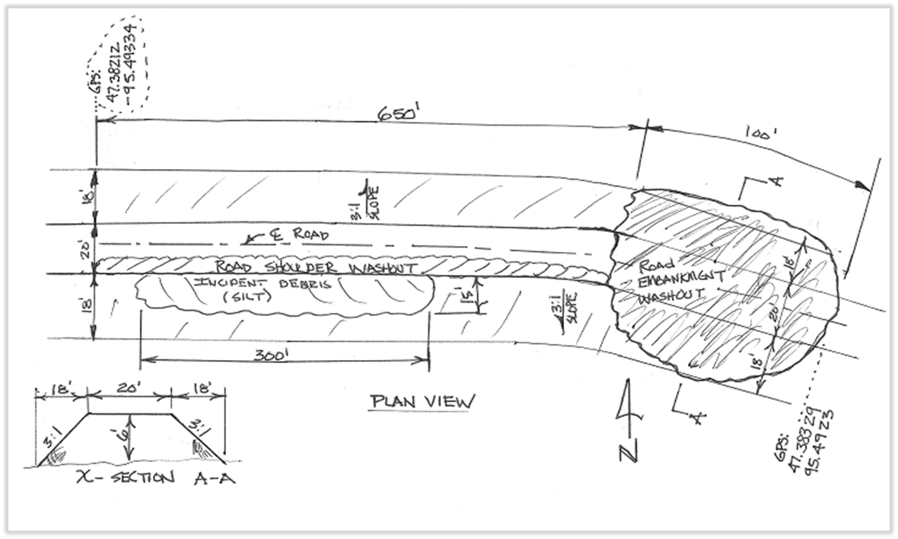
Phase II – Introduction to the FEMA Site Inspector
What Site Inspectors are there to do:
Collect damage specific information (Who, what, when, where, how, and how much)
Take Photographs
Develop site sketches
Create site maps
Notes:
Instructor Notes:
Expand upon the Bullet points above as necessary.

Slide 49
Phase II – Introduction to the FEMA Site Inspector
What Site Inspectors are there to do (Cont.):
Only inspect sites specified on the work order
Work with the Applicant at all times during the site inspection process
Reach field level concurrence with applicant
Conduct a positive and engaged relationship with the Applicant.
Assist Counterparts: If Mitigation of Environmental and Historic Preservation Specialists are present.
Notes:
Instructor Notes:
- Follow the Bullet points in discussion and remind the participants that jobs are being defined by task in accordance within a defined Position Assist.

Slide 50
Phase II – Introduction to the FEMA Site Inspector
What Site Inspectors are NOT there to do:
Self identify damages
Proceed to damaged sites alone
Inspect sites not identified on the Work Order
Determine and/or discuss FEMA eligibility
Notes:
Instructor Notes:
- Follow the Bullet points in discussion and remind the participants that jobs are being defined by task in accordance within a defined Position Assist.

Slide 51
Phase II – Introduction to the FEMA Site Inspector
Activity – The FEMA Site Inspector Position Assist:
Notes:
Instructor Notes:
Have the Applicants open the Site Inspector Position Assist. Review and detail the components and content.
Review job functions and timelines.

Slide 52
Phase II – Introduction to the FEMA Site Inspector
Applicant Consideration: What if sites are missing from the FEMA Work Order?
The Site may be located on a separate work order.
The missing site may not have been identified on the Damage Inventory.
Damage was not inventoried within 60 Days of the Recovery Scoping Meeting (RSM)
Notes:
Instructor Notes:
Instructor should invest time to review all considerations on the slide and enter into discussion with the class about each. Depending on circumstance, the Applicant may need to engage in additional discussion with the Program Delivery Manager. The Site Inspector may be able to help with bridging the conversation and reconciling any concerns prior to the Site Inspection.
Remind the class that Site Inspectors can not visit sites not specified on the Work Order.

Slide 53
Phase II – FEMA Site Inspector Report Forms and Tools
In the Field, FEMA Site Inspectors use:
Site Inspection Report Forms
Tools:
- Hazardous Tree Calculator
- GPS Distance Calculator
- Calculations and Conversions Tool
Notes:
Instructor Notes:
Forms and Tools have been implemented to:
1.) Streamline the Job
2.) Ensure consistency
3.) Annotate damage
4.) Guarantee ALL essential information is collected
5.) Achieve field level agreement

Slide 54
Phase II – FEMA Site Inspector Report Forms and Tools
Can forms and tools be useful to Applicants and Recipients too?
Reference Documents
A component of the Project Specific File
Provision of conversion factors
*** Applicants may use the forms and tools to simplify work.
Notes:
Instructor Notes:
- Discuss potential benefits of the Applicant and Recipient to use the FEMA Tools on a day to day basis.

Slide 55
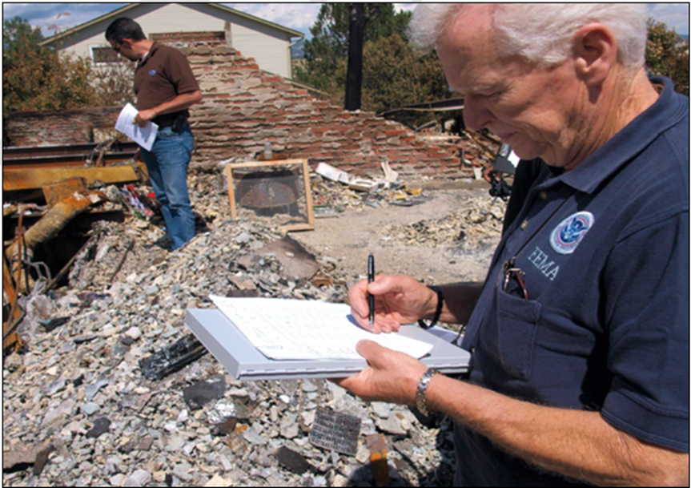
Phase II – FEMA Site Inspector Report Forms and Tools
Overview: Site Inspection Report Forms
Specific to the category of work (A-G)
Specialized to the type of work
Address Special Considerations
Capture:
- GPS Coordinates
- Date and cause of damage
- Damaged components
- Damage dimensions
Notes:
Instructor Notes:
- Work through the Bullet Points and Proceed to next slide.

Slide 56
Phase II – FEMA Site Inspector Report Forms and Tools
Forms Overview
Notes:
Instructor Note:
- Take time with the class to show participants each of the 20 Site Inspection Report Forms. Highlight the components of the forms and show the differences of each (how they are designed to address specific work).

Slide 57
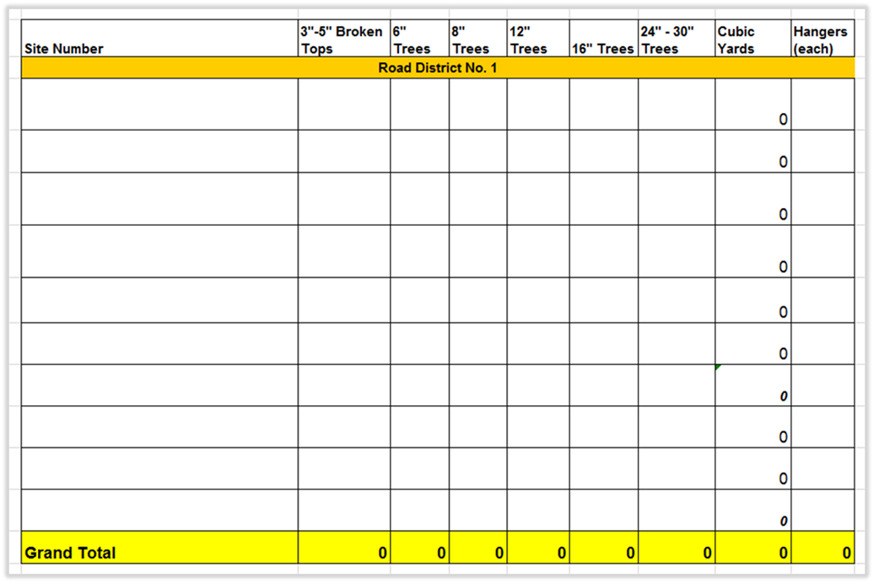
Phase II – FEMA Site Inspector Report Forms and Tools
Tools: Hazardous Tree Calculator
Notes:
Instructor Notes:
Have the participants open the tool on their laptop. Describe the tools purpose and how it can assist the Applicant/Recipient/Site Inspector.
Give samples for input into the form, so the Attendees may practice using it.

Slide 58
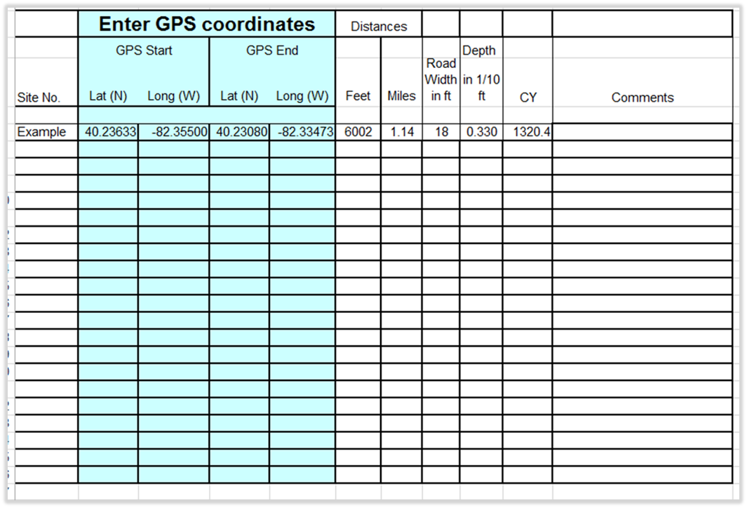
Phase II – FEMA Site Inspector Report Forms and Tools
Tools: GPS Distance Calculator
Notes:
Instructor Notes:
Have the participants open the tool on their laptop. Describe the tools purpose and how it can assist the Applicant/Recipient/Site Inspector.
Give samples for input into the form, so the Attendees may practice using it.

Slide 59
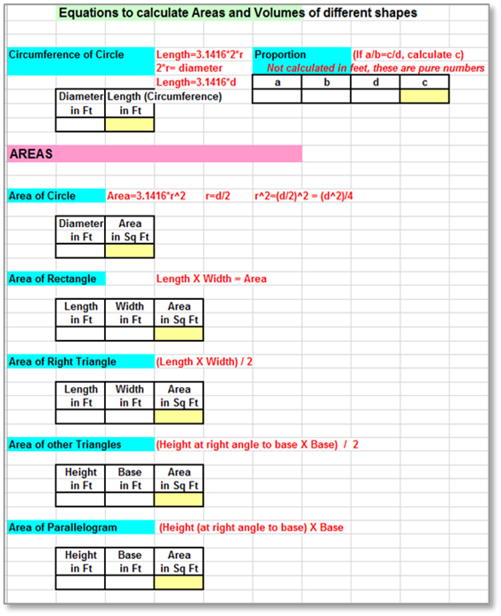
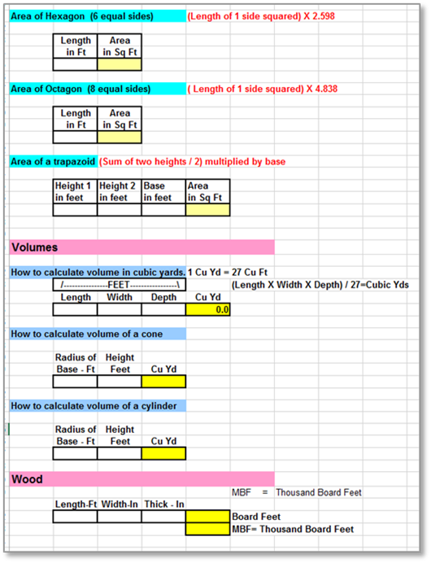
Phase II – FEMA Site Inspector Report Forms and Tools
Tools: Areas of Shapes/Volumes
Notes:
Instructor Notes:
Have the participants open the tool on their laptop. Describe the tools purpose and how it can assist the Applicant/Recipient/Site Inspector.
Give samples for input into the form, so the Attendees may practice using it.

Slide 60
Phase II – FEMA Site Inspector Report Forms and Tools
Tools: Calculations
Notes:
Instructor Notes:
Have the participants open the tool on their laptop. Describe the tools purpose and how it can assist the Applicant/Recipient/Site Inspector.
Give samples for input into the form, so the Attendees may practice using it.

Slide 61
Phase II – FEMA Site Inspector Report Forms and Tools
Tools: Conversions
Notes:
Instructor Notes:
Have the participants open the tool on their laptop. Describe the tools purpose and how it can assist the Applicant/Recipient/Site Inspector.
Give samples for input into the form, so the Attendees may practice using it.

Slide 62
Phase II – FEMA Site Inspector Report Forms and Tools
Tools: Conversions
Notes:
Instructor Notes:
Have the participants open the tool on their laptop. Describe the tools purpose and how it can assist the Applicant/Recipient/Site Inspector.
Give samples for input into the form, so the Attendees may practice using it.

Slide 63
Phase II – FEMA Site Inspector Report Forms and Tools
Tools: Conversions
Notes:
Instructor Notes:
Have the participants open the tool on their laptop. Describe the tools purpose and how it can assist the Applicant/Recipient/Site Inspector.
Give samples for input into the form, so the Attendees may practice using it.

Slide 64
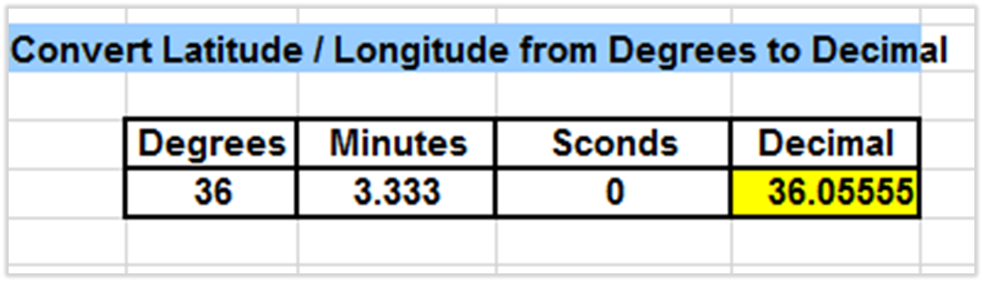
Phase II – FEMA Site Inspector Report Forms and Tools
Tools: GPS Conversions
FEMA uses the Degree Decimal GPS Format.
Applicants need to use the same in reporting locations.
GPS Coordinates may be converted using the Tool.
Notes:
Instructor Notes:
Have the participants open the tool on their laptop. Describe the tools purpose and how it can assist the Applicant/Recipient/Site Inspector.
Give samples for input into the form, so the Attendees may practice using it.

Slide 65
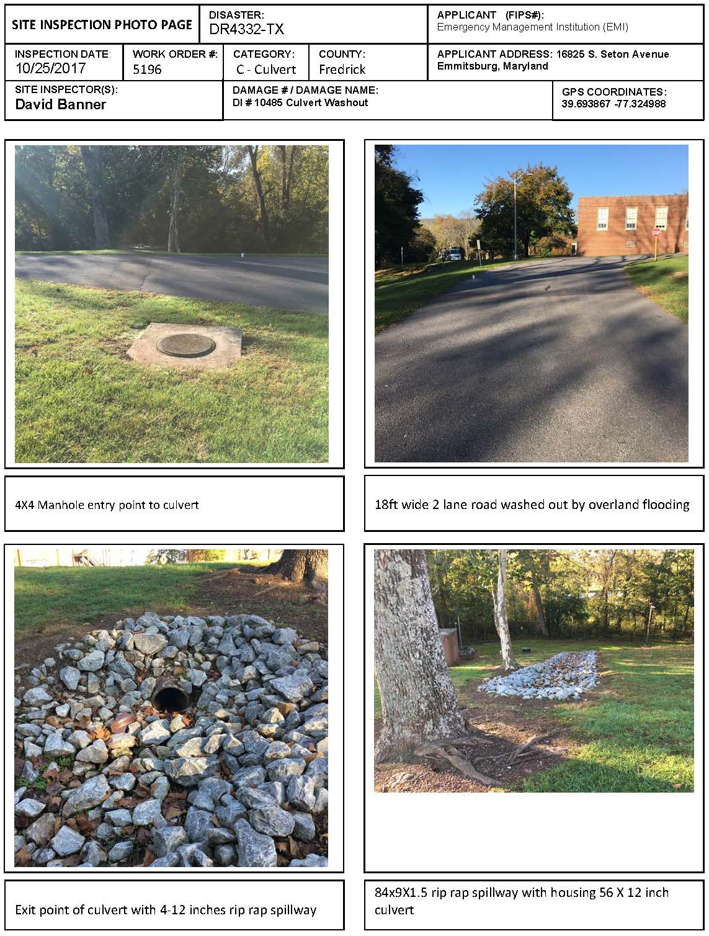
Phase II – FEMA Site Inspector Report Forms and Tools
Tools: Photo Page
Notes:
Instructor Notes:
Have the participants open the tool on their laptop. Describe the tools purpose and how it can assist the Applicant/Recipient/Site Inspector.
Give samples for input into the form, so the Attendees may practice using it.

Slide 66
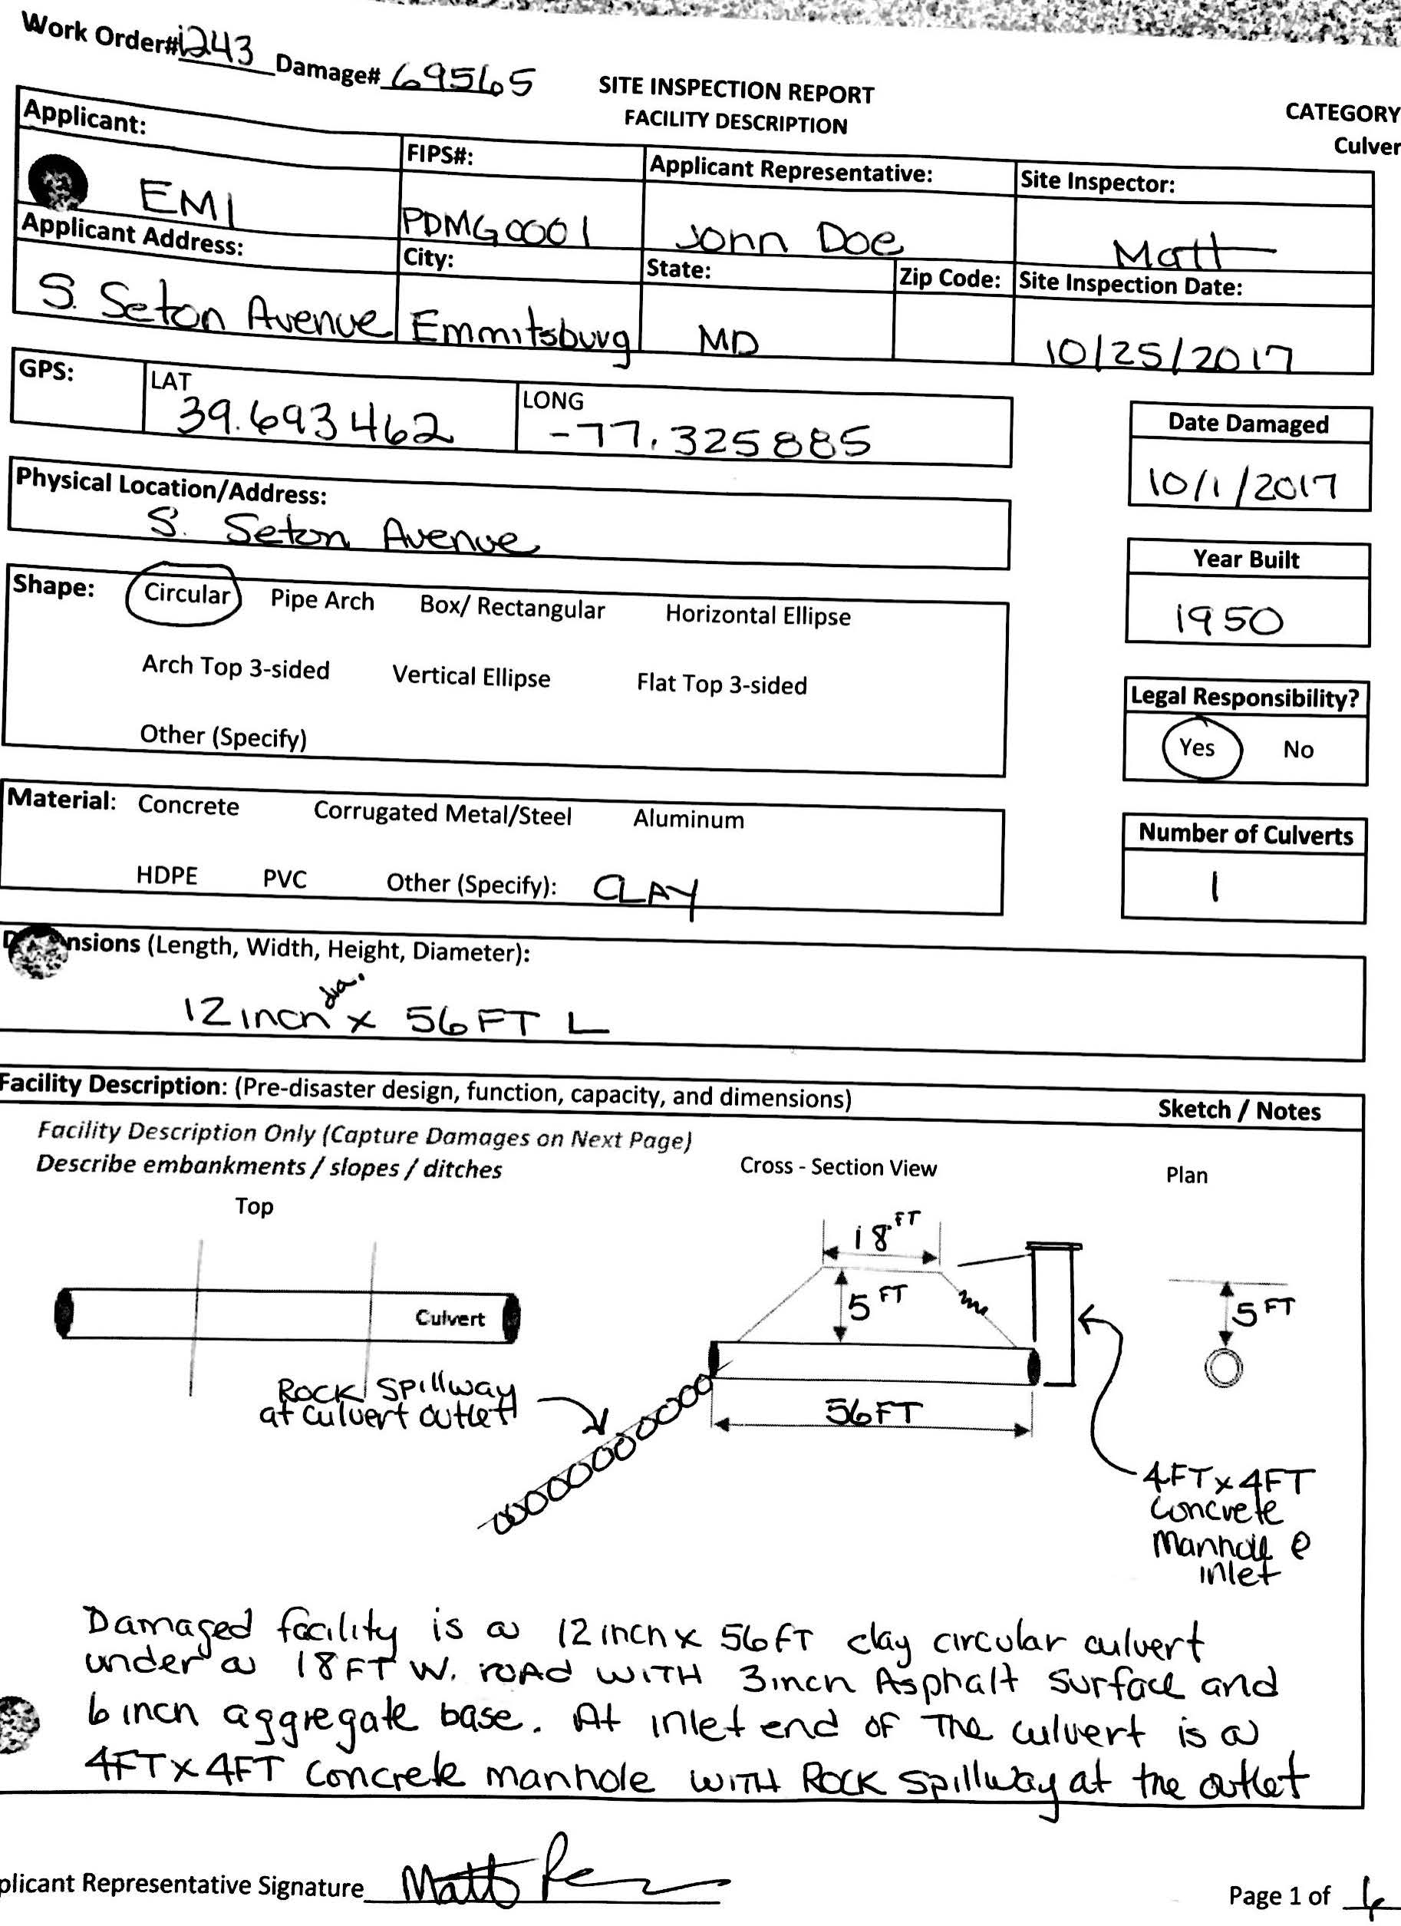
Phase II – FEMA Site Inspector Report Forms and Tools
Tools: SI Report
Notes:
Instructor Notes:
Have the participants open the tool on their laptop. Describe the tools purpose and how it can assist the Applicant/Recipient/Site Inspector.
Give samples for input into the form, so the Attendees may practice using it.

Slide 67
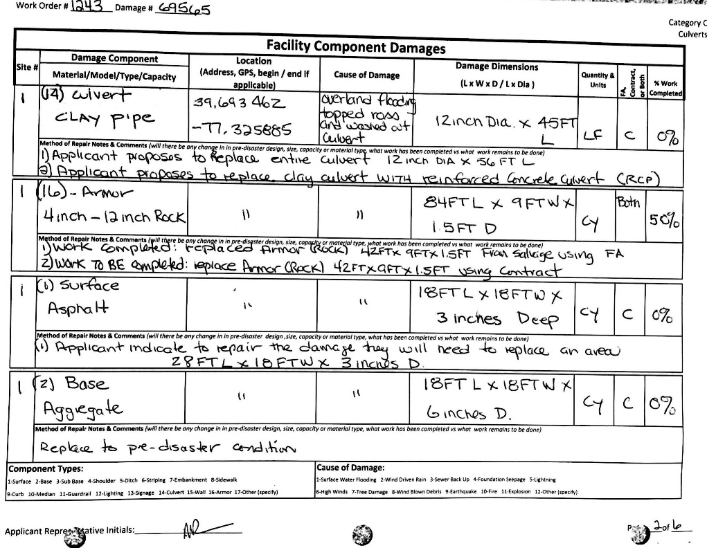
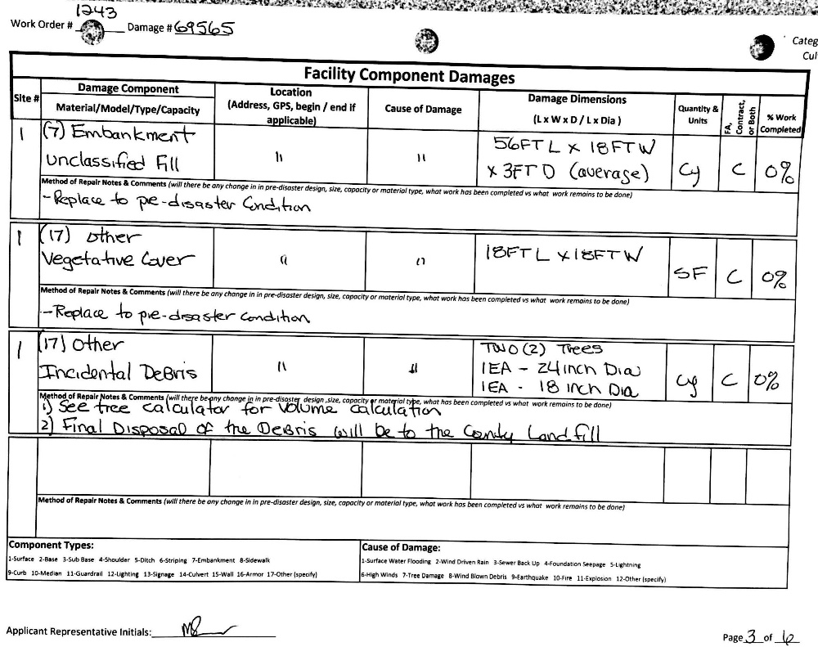
Phase II – FEMA Site Inspector Report Forms and Tools
Tools: SI Report
Notes:
Instructor Notes:
Have the participants open the tool on their laptop. Describe the tools purpose and how it can assist the Applicant/Recipient/Site Inspector.
Give samples for input into the form, so the Attendees may practice using it.

Slide 68
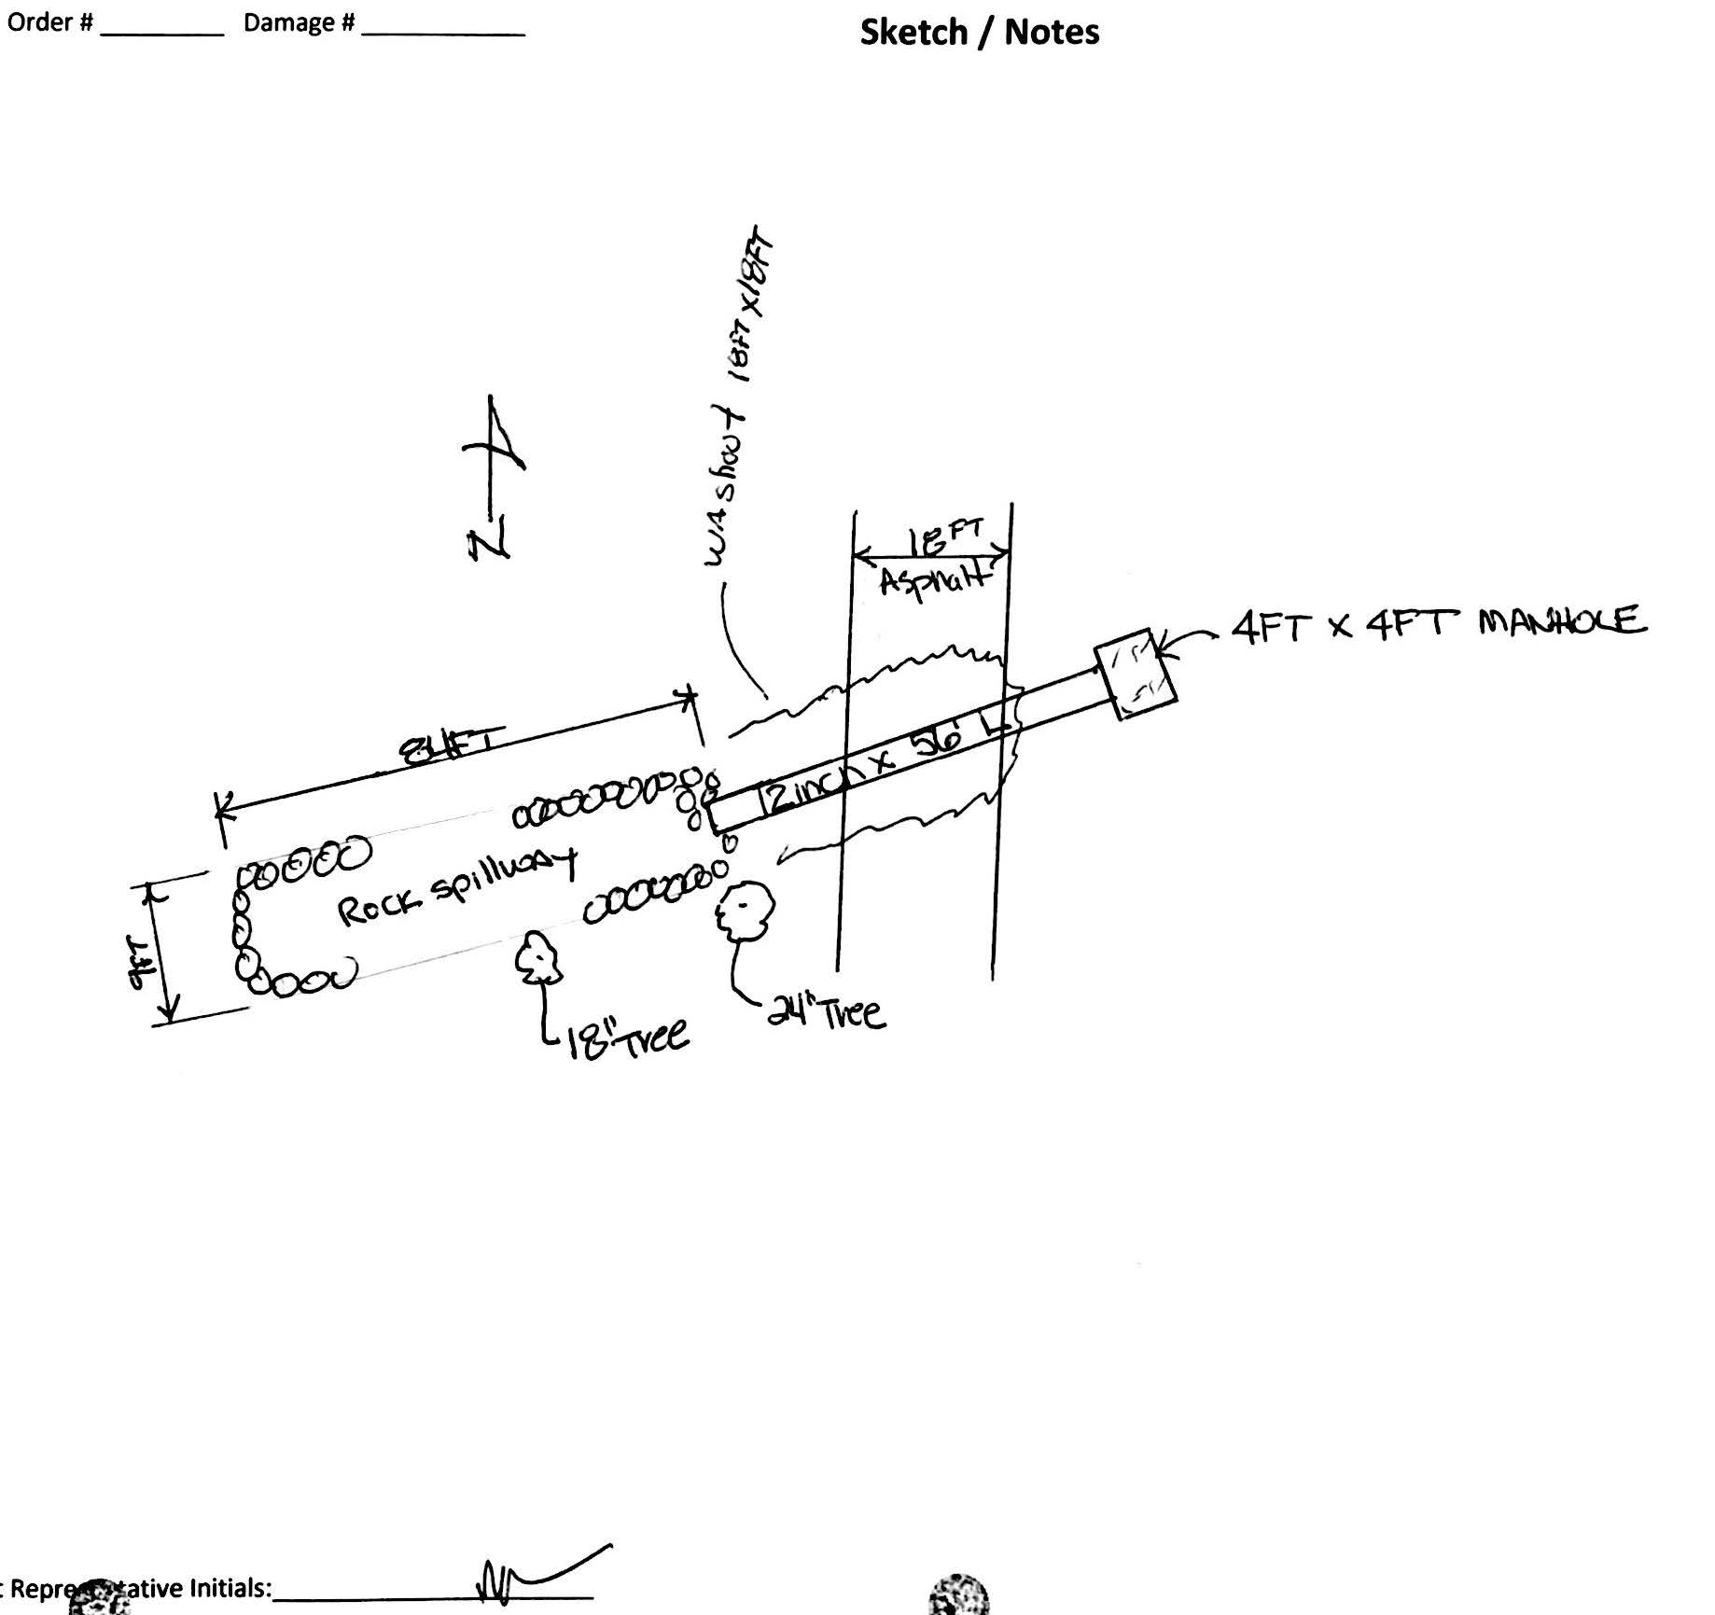
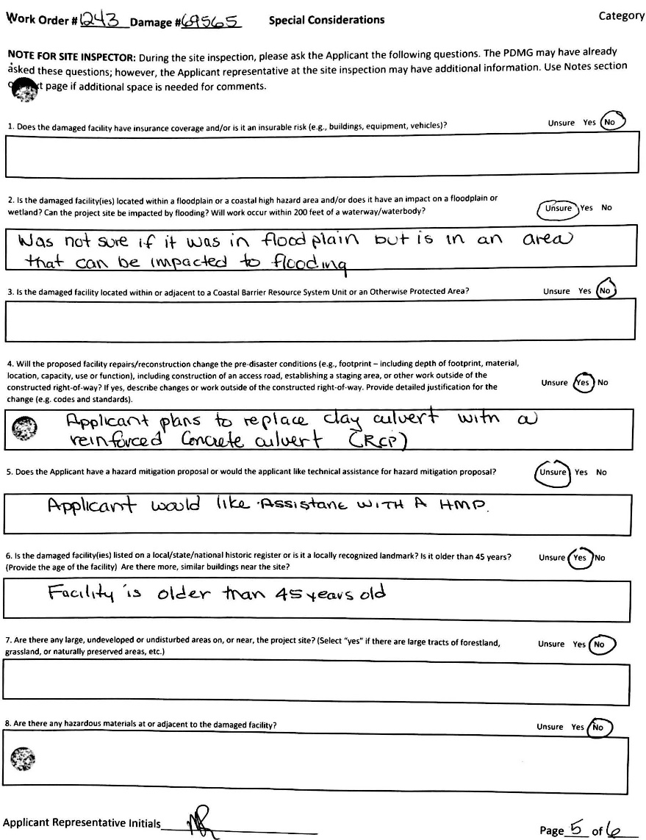
Phase II – FEMA Site Inspector Report Forms and Tools
Tools: SI Report
Notes:
Instructor Notes:
Have the participants open the tool on their laptop. Describe the tools purpose and how it can assist the Applicant/Recipient/Site Inspector.
Give samples for input into the form, so the Attendees may practice using it.

Slide 69
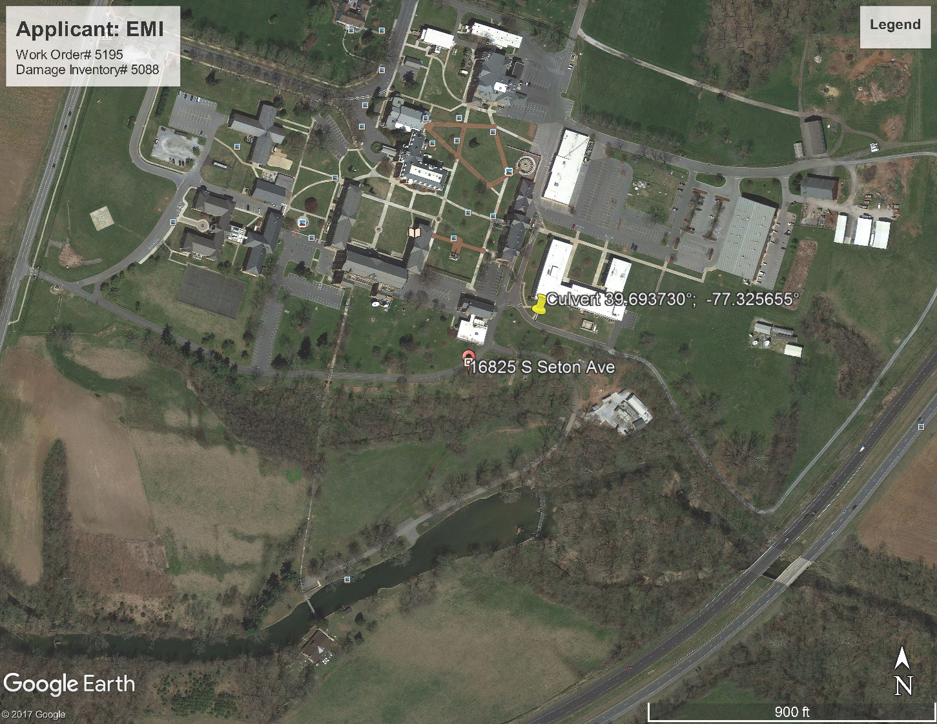
Phase II – FEMA Site Inspector Report Forms and Tools
Tools: Location Map
Notes:
Instructor Notes:
Have the participants open the tool on their laptop. Describe the tools purpose and how it can assist the Applicant/Recipient/Site Inspector.
Give samples for input into the form, so the Attendees may practice using it.

Slide 70
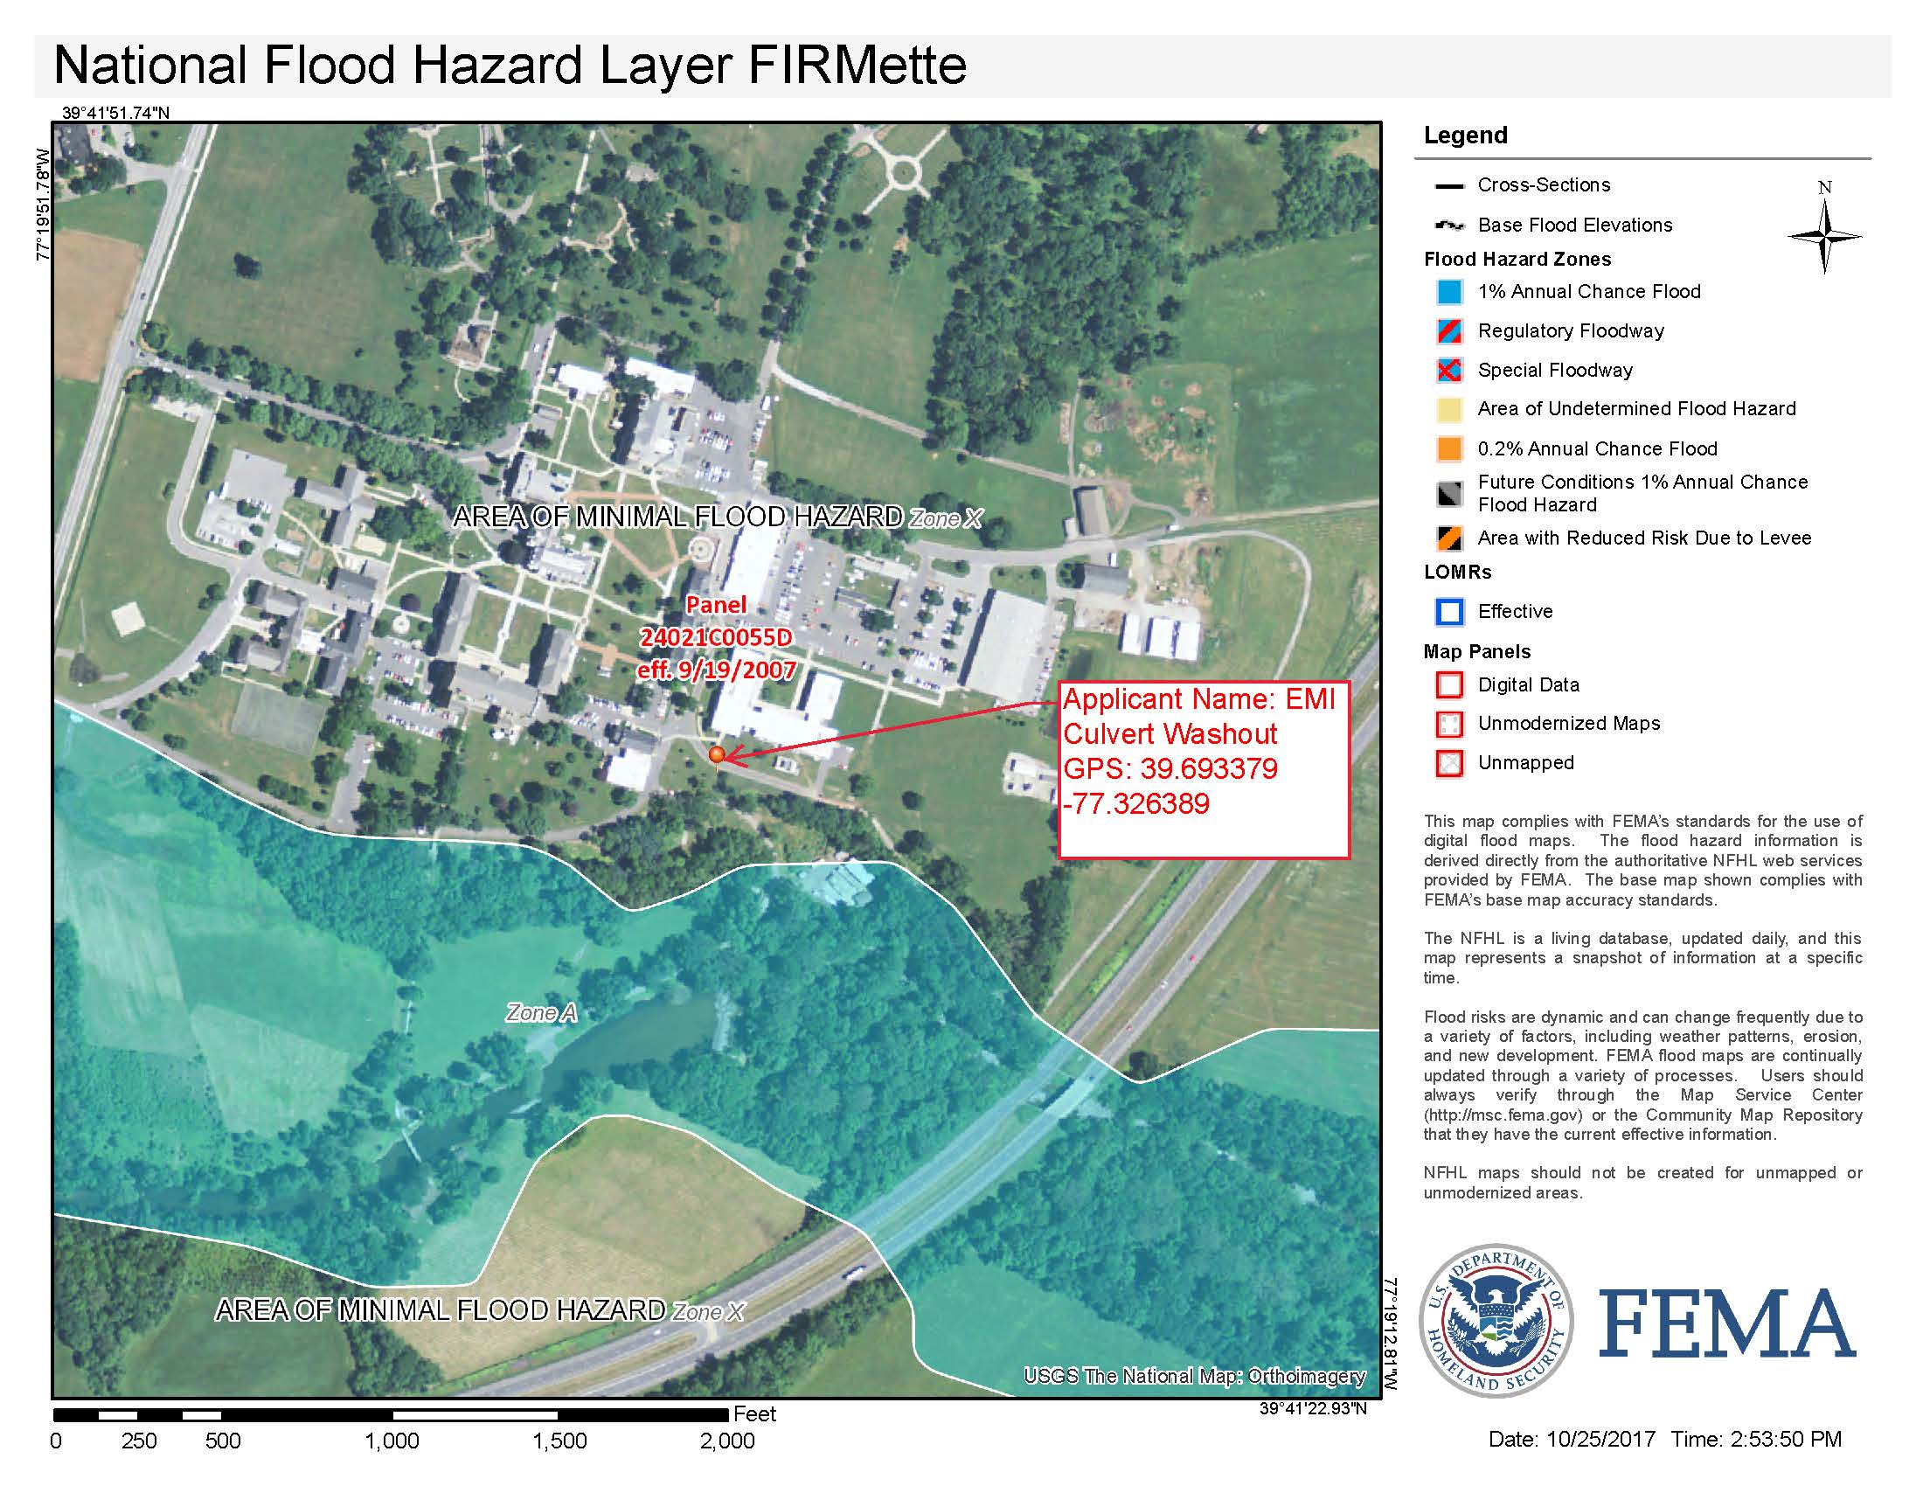
Phase II – FEMA Site Inspector Report Forms and Tools
Tools: FIRMette
Notes:
Instructor Notes:
Have the participants open the tool on their laptop. Describe the tools purpose and how it can assist the Applicant/Recipient/Site Inspector.
Give samples for input into the form, so the Attendees may practice using it.

Slide 71
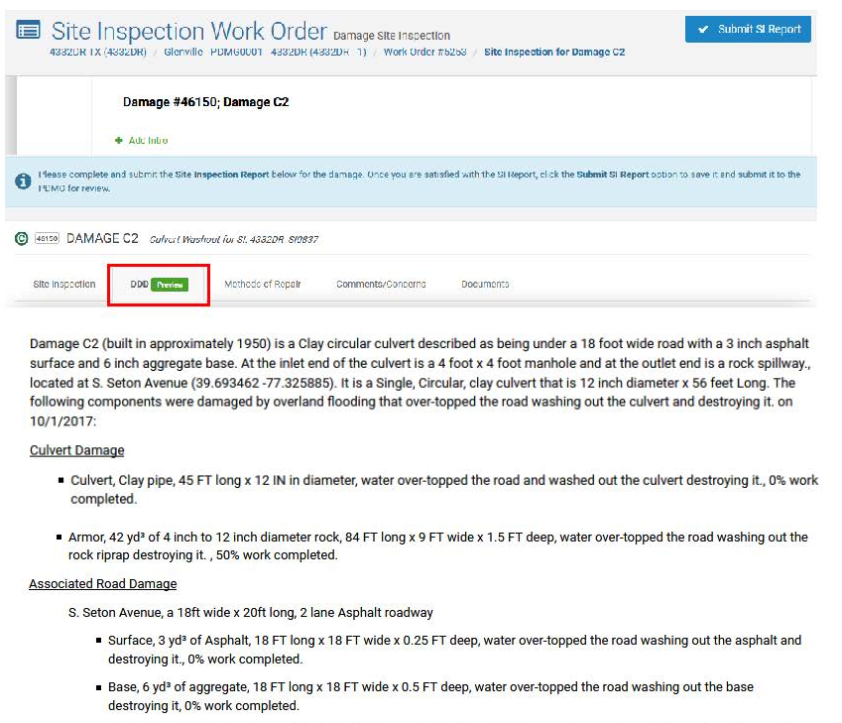
Phase II – FEMA Site Inspector Report Forms and Tools
Notes:
Instructor Notes:
Have the participants open the tool on their laptop. Describe the tools purpose and how it can assist the Applicant/Recipient/Site Inspector.
Give samples for input into the form, so the Attendees may practice using it.

Slide 72
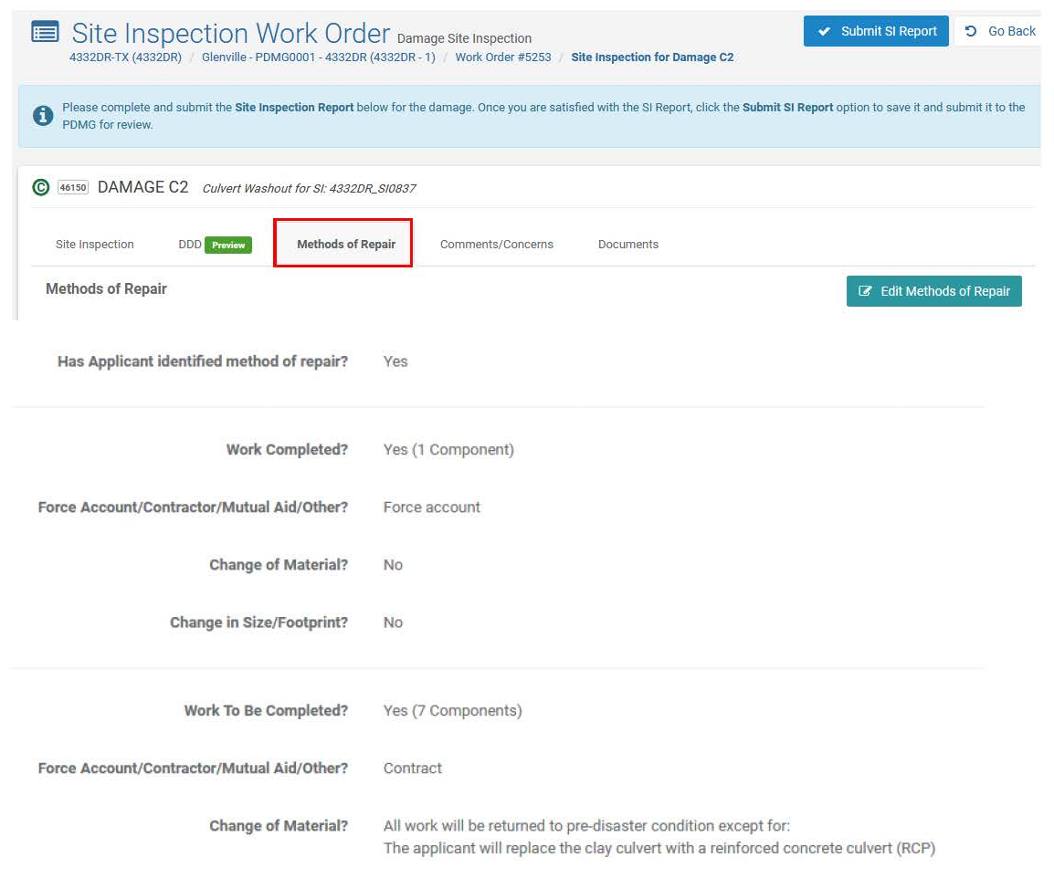
Phase II – FEMA Site Inspector Report Forms and Tools
Notes:
Instructor Notes:
Have the participants open the tool on their laptop. Describe the tools purpose and how it can assist the Applicant/Recipient/Site Inspector.
Give samples for input into the form, so the Attendees may practice using it.

Slide 73
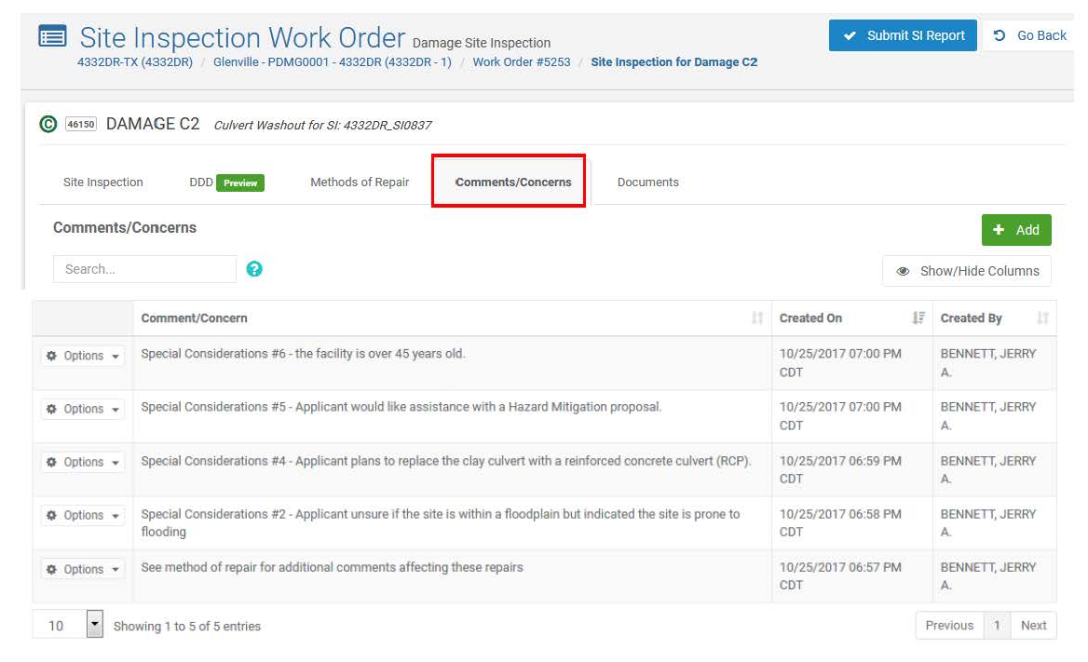
Phase II – FEMA Site Inspector Report Forms and Tools
Notes:
Instructor Notes:
Have the participants open the tool on their laptop. Describe the tools purpose and how it can assist the Applicant/Recipient/Site Inspector.
Give samples for input into the form, so the Attendees may practice using it.

Slide 74

Phase II – FEMA Site Inspector Report Forms and Tools
Notes:
Instructor Notes:
Have the participants open the tool on their laptop. Describe the tools purpose and how it can assist the Applicant/Recipient/Site Inspector.
Give samples for input into the form, so the Attendees may practice using it.

Slide 75

Phase II – Intake Damage and Eligibility Analysis – Action Items
Following Damage Description Applicant Signature
→ Project proceeds to Phase III Scoping and Costing after all documents have been collected.
DEMO: HOW THE SITE
INSPECTION REPORT
DEVELOPS INTO A
DAMAGE DESCRIPTION
Notes:
Instructor Notes:
- The Demo is to show how the FEMA Site Inspector Enters the SI Report Into the Grants Manager, to develop the DDD. Go live.

Slide 76

Phase II – Intake Damage and Eligibility Analysis – Action Items
Step 1: Enter Work Order #
Step 2: Drill in to Work Order

Slide 77

Phase II – Intake Damage and Eligibility Analysis – Action Items
Click Complete Site Inspection

Slide 78

Phase II – Intake Damage and Eligibility Analysis – Action Items
Step 1: Click Add

Slide 79

Phase II – Intake Damage and Eligibility Analysis – Action Items
Select Damaged Component
Click Add

Slide 80

Phase II – Intake Damage and Eligibility Analysis – Action Items
Click Options/Save

Slide 81

Phase II – Intake Damage and Eligibility Analysis – Action Items
Click DDD tab

Slide 82

Phase II – Intake Damage and Eligibility Analysis – Action Items
Activity Time:
Uploading Documents in Grants Portal
(Organization & Event Profile Areas)
Notes:
Instructor Notes:
- Have the Participants open the Position Assist. Review all the components and discuss the PDMG Roles throughout.

Slide 83

FEMA’s Public Assistance
Grants Portal
What are general documents?

Slide 84

https://grantsportal-demo-site.azurewebsites.net
Log back into the Demo Grants Portal Site

Slide 85

Under “My Organization” click “Event PA Requests” and select CO-EOC by clicking the magnifying glass 🔍 on the left

Slide 86

Under “Event Profile” scroll down to “Documents” bar and click “Manage” button on the right

Slide 87

Click green “Add Document” button to upload a document

Slide 88

In the pop-up box, click green “Select Document” button and choose a SAFE document from your desktop to upload
Notice Maximum File Size is currently at 100 MB.

Slide 89

Search by “File name” in “File Upload” pop-up box and click “Open” button

Slide 90

Fill out all attachment identifiers and click
“Add Document” button
Notice user can assign more than one category/tag to identify the type of attachment.

Slide 91

Uploading… Screen with “Cancel” button option

Slide 92

Manage Documents with Edit/Remove button options,
Add additional documents by clicking “Add Document”

Slide 93

Go Under: Event PA Request – My Event Request Profile - scroll down and expand “Documents” bar to view list of attachments under Profile (same for the Organization area)

Slide 94

Select blue icon to the left of an Uploaded Document to open and view the attachment from the “Documents” bar

Slide 95

Downloaded Document

Slide 96

Documents should be placed under “My Organization Profile” if the items are not specific to an Event (i.e. Insurance Policy)

Slide 97

Once Documents exercise is complete, go ahead and sign out of your Demo Grants Portal Account

Slide 98

Phase II – Intake Damage and Eligibility Analysis – Action Items
Scope of Work and Cost: Decision Making Considerations for Applicants
Does the Applicant have a Certified Engineer or Qualified Cost Estimator Available?
Are documented local costs (unit costs) readily available?
Is the disaster recovery on a scale where taking on scoping and costing is beyond capacity?
Does the work require specialized expertise/ factors/ considerations?
Notes:
Instructor Notes:
It is critical to have an open discussion of considerations with Recipients and Applicants
Overview the considerations, discuss any others that may be brought up in class.
Keep the discussion Applicant focused
Special Instructor Note: Remind Applicants that FEMA has specialized staff with expertise in working with large and complex projects, who are ready to assist.

Slide 99
Phase II – Intake Damage and Eligibility Analysis – Action Items
Scope of Work and Costs: Decision Making Considerations for Applicants
Throughout the process, the FEMA Program Delivery Manager continues to:
  Work with/Support the Applicant
  Coordinates with the Consolidated Resource Center regarding project development
  Meets with the Applicant to achieve full document disclosure
Recipients have a partnership opportunity throughout this engagement.
Notes:
Instructor Notes:
It is critical to remind Applicants that the PDMG remains in place throughout the grant process – continues to work with the Applicant
Emphasize to the Audience that the Recipient may have a critical role in mirroring the PDMG. The recipient may choose to partner, opening up roles for the recipient to assist the Applicant and the FEMA PDMG.

Slide 100

Questions
Notes:
Conclusion of Unit
– Take brief moment to address any final questions before proceeding.

Slide 101

Conclusion of Unit 4
Course Evaluation and Comment
Notes:
Instructor Notes:
Have students complete the Unit 4 portion of the evaluation. Include time for comments and feedback.

